Slide 1
Name of Institution or University
PhD Thesis Defense: Tau Propagation and Microglial State in Alzheimer's Disease
Your name here
Thesis defense
PhD candidate, Neuroscience
Date of defense
Notes:
💡 The topic and the occasion, readable at a glance.
Template by SciFig
More free presentation templates for conferences, lab meetings, journal clubs and thesis defenses: scifig.ai/go/sldb-mor

Slide 2
Name of Institution or University
PhD Thesis Defense: Tau Propagation and Microglial State in Alzheimer's Disease
Want a different color palette? One change recolors the whole deck.
PowerPoint — Design → Variants → Colors → Customize Colors. Fonts: Design → Variants → Fonts.
Google Slides — Slide → Edit theme → Colors.
Need more detail? Read the full recoloring guide.
Delete this slide when you are done.
Your name here
Thesis defense
PhD candidate, Neuroscience
Date of defense
Notes:
💡 A working copy of the title slide — recolor the deck here, then delete this slide.
Template by SciFig
More free presentation templates for conferences, lab meetings, journal clubs and thesis defenses: scifig.ai/go/sldb-mor

Slide 3
I
Research background
II
Hypothesis and objectives
Table of Contents
III
Methodology
IV
Results
V
Discussion and next steps
Notes:
💡 The shape of the talk: how many parts, and where the results sit.
Template by SciFig
More free presentation templates for conferences, lab meetings, journal clubs and thesis defenses: scifig.ai/go/sldb-mor

Slide 4
Chapter Overview
1
Chapter 1 — introduction and literature review. For example, "The amyloid cascade hypothesis and what four decades of trials have and have not shown."
2
Chapter 2 — first study. For example, "Whether tau spread follows the connectivity map or simple anatomical proximity."
3
Chapter 3 — second study. For example, "Whether microglial state predicts plaque clearance in the same cohort."
4
Chapter 4 — synthesis and general discussion.
Notes:
💡 The thesis in the order it is bound, one line per chapter.
Template by SciFig
More free presentation templates for conferences, lab meetings, journal clubs and thesis defenses: scifig.ai/go/sldb-mor

Slide 5
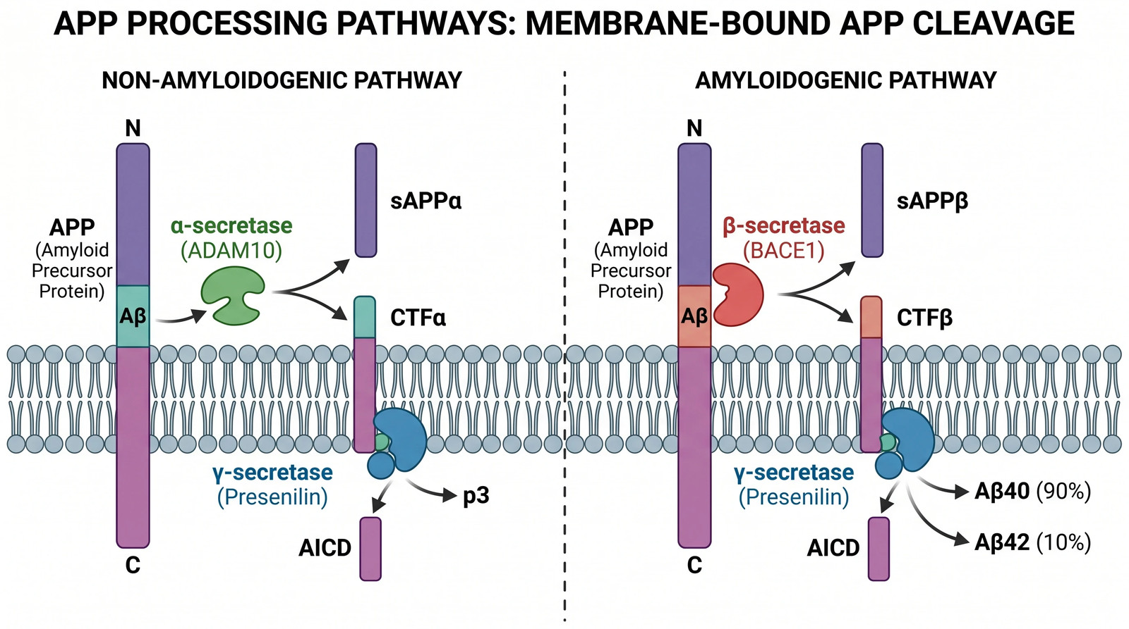
I · RESEARCH BACKGROUND
Introduction
Alzheimer's pathology is defined by two lesions — amyloid plaques and neurofibrillary tangles — that appear on different timescales and in different places.
Amyloid burden correlates poorly with cognitive decline, while tau staging tracks it closely.
That mismatch is the reason this thesis is about tau rather than about amyloid.
Need a diagram like this? Describe it and create one in seconds at SciFig.
Notes:
💡 Only the background needed to follow what comes next.
🖼 This example figure was generated with SciFig — see the prompt at scifig.ai/go/sldb-prm
Template by SciFig
More free presentation templates for conferences, lab meetings, journal clubs and thesis defenses: scifig.ai/go/sldb-mor

Slide 6
I · RESEARCH BACKGROUND
One Figure, One Message
Drop your key figure here.
One slide, one message — if it needs two, make two slides.
No figure fits your data? Describe it and create one in seconds at SciFig.
Notes:
💡 The single figure this talk is built around.
Template by SciFig
More free presentation templates for conferences, lab meetings, journal clubs and thesis defenses: scifig.ai/go/sldb-mor

Slide 7
I · RESEARCH BACKGROUND
Knowledge Gap and Open Questions
What is not yet known
Questions this work asks
State it plainly. For example, "It is unclear whether tau spreads along connections or simply to whatever is nearby."
Why it has persisted. For example, "Connectivity and proximity are almost perfectly correlated in the usual regions."
What closing it changes. For example, "It decides whether network-based prediction is possible."
Can connectivity and proximity be separated in the same brain?
Does staging order follow the connectome or the anatomy?
Does microglial state change the rate either way?
Notes:
💡 What is unknown, why it stayed unknown, and what closing it buys.
Template by SciFig
More free presentation templates for conferences, lab meetings, journal clubs and thesis defenses: scifig.ai/go/sldb-mor

Slide 8
II · HYPOTHESIS AND OBJECTIVES
The Testable Claim
We hypothesize that tau pathology propagates along synaptic connectivity rather than by spatial proximity, and that microglial state modulates the rate.
The same shape, blank: "We hypothesize that [independent variable] will [expected effect] on [dependent variable] in [population or condition]."
Keep it testable, specific and falsifiable.
Notes:
💡 The one sentence the whole talk is built to test.
Template by SciFig
More free presentation templates for conferences, lab meetings, journal clubs and thesis defenses: scifig.ai/go/sldb-mor

Slide 9
II · HYPOTHESIS AND OBJECTIVES
Research Objectives
1
What you set out to measure. For example, "To quantify how knockout of the regulator changes pathway output over 24 hours."
2
What you set out to compare. For example, "To compare the knockout against a wild-type rescue as a specificity control."
3
What you set out to validate. For example, "To confirm the phenotype in a second, independent cell line."
4
What you set out to replicate. For example, "To repeat the time-course with an independent guide RNA."
Notes:
💡 Each objective maps one-to-one onto a row of the summary table.
Template by SciFig
More free presentation templates for conferences, lab meetings, journal clubs and thesis defenses: scifig.ai/go/sldb-mor

Slide 10
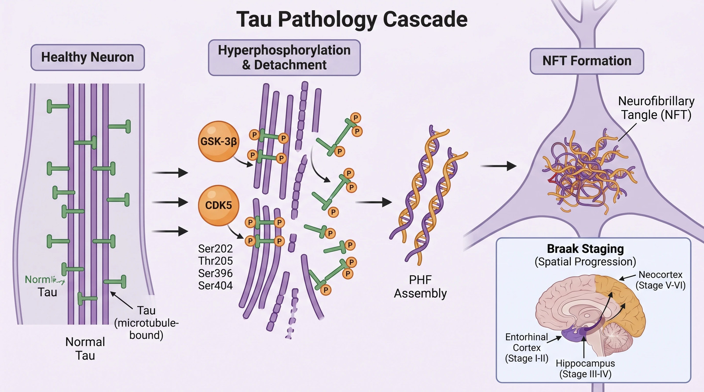
III · METHODOLOGY
Study Design and Methods
Design and sample size. For example, "Post-mortem series of 62 cases spanning Braak I-VI, with a matched control arm."
Key technique and why. For example, "Region-paired staging rather than whole-brain burden, because the question is about spatial order, not amount."
Controls and statistics. For example, "Connectivity and proximity entered as competing predictors in the same model."
Need a diagram like this? Describe it and create one in seconds at SciFig.
Notes:
💡 Design, technique, controls, and statistics.
🖼 This example figure was generated with SciFig — see the prompt at scifig.ai/go/sldb-prm
Template by SciFig
More free presentation templates for conferences, lab meetings, journal clubs and thesis defenses: scifig.ai/go/sldb-mor

Slide 11
III · METHODOLOGY
Timeline of the Doctoral Work
1
Year 1 — training, pilot work, protocol development. For example, "Histology training and staining protocol validation."
2
Year 2 — main data collection. For example, "Full staging series across the cohort."
3
Year 3 — second study and replication. For example, "Independent validation cohort and the imaging arm."
4
Year 4 — analysis, writing, and submission.
Notes:
💡 What happened in each year, and what shifted the schedule.
Template by SciFig
More free presentation templates for conferences, lab meetings, journal clubs and thesis defenses: scifig.ai/go/sldb-mor

Slide 12
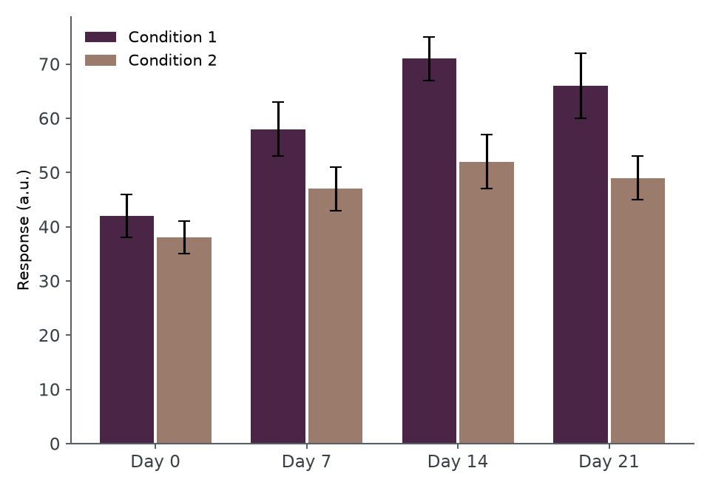
IV · RESULTS
Result 1 — For Example, "Knockout Sustains Pathway Activation Past 12 Hours"
Lead with what you found in plain language, then point at the part of the figure that shows it.
Give the effect size and its uncertainty, not just the p-value. For example, "2.4-fold higher at 12 h (95% CI 1.8-3.1)."
Title this slide with the finding rather than with "Result 1" — a title that states the result does half the talking for you.
Describe this figure in one line: what is plotted, and what it shows.
Notes:
💡 What was found, with effect size and uncertainty.
🖼 This example figure was generated with SciFig — see the prompt at scifig.ai/go/sldb-prm
Template by SciFig
More free presentation templates for conferences, lab meetings, journal clubs and thesis defenses: scifig.ai/go/sldb-mor

Slide 13
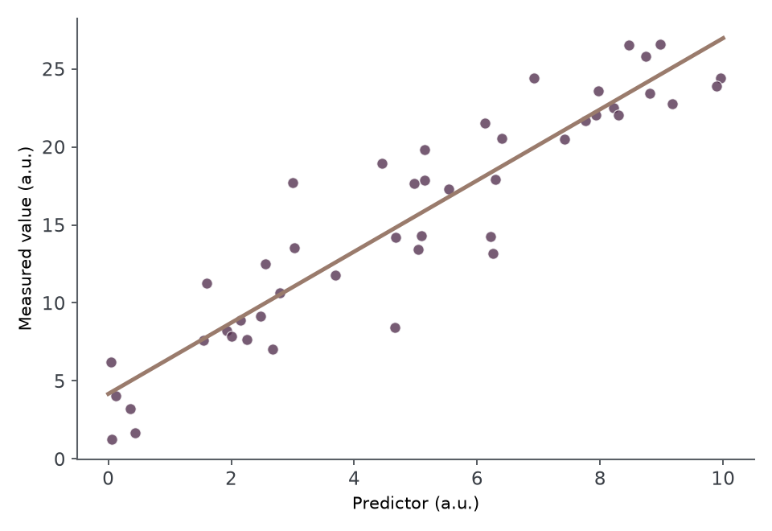
IV · RESULTS
Result 2 — For Example, "The Effect Scales With Baseline Expression"
What changed between conditions. For example, "The same trend held in the replication line, with a smaller slope."
Any result that went against your expectation — say it here. For example, "The rescue only partially reversed the phenotype."
Say what the axes are before you say what they mean.
Describe this figure in one line: what is plotted, and what it shows.
Notes:
💡 What changed between conditions, including anything unexpected.
🖼 This example figure was generated with SciFig — see the prompt at scifig.ai/go/sldb-prm
Template by SciFig
More free presentation templates for conferences, lab meetings, journal clubs and thesis defenses: scifig.ai/go/sldb-mor

Slide 14
IV · RESULTS
Summary of Findings
Objective | What we found | Confidence
Quantify pathway output | Activation sustained 2.4-fold past 12 h | High
Compare against rescue | Rescue reverses the effect only partially | Moderate
Validate in a second line | Same direction, smaller effect size | Preliminary
Replicate with a second guide | Consistent, with a wider confidence interval | Moderate
Notes:
💡 One row per objective, with how far each result can be pushed.
Template by SciFig
More free presentation templates for conferences, lab meetings, journal clubs and thesis defenses: scifig.ai/go/sldb-mor

Slide 15
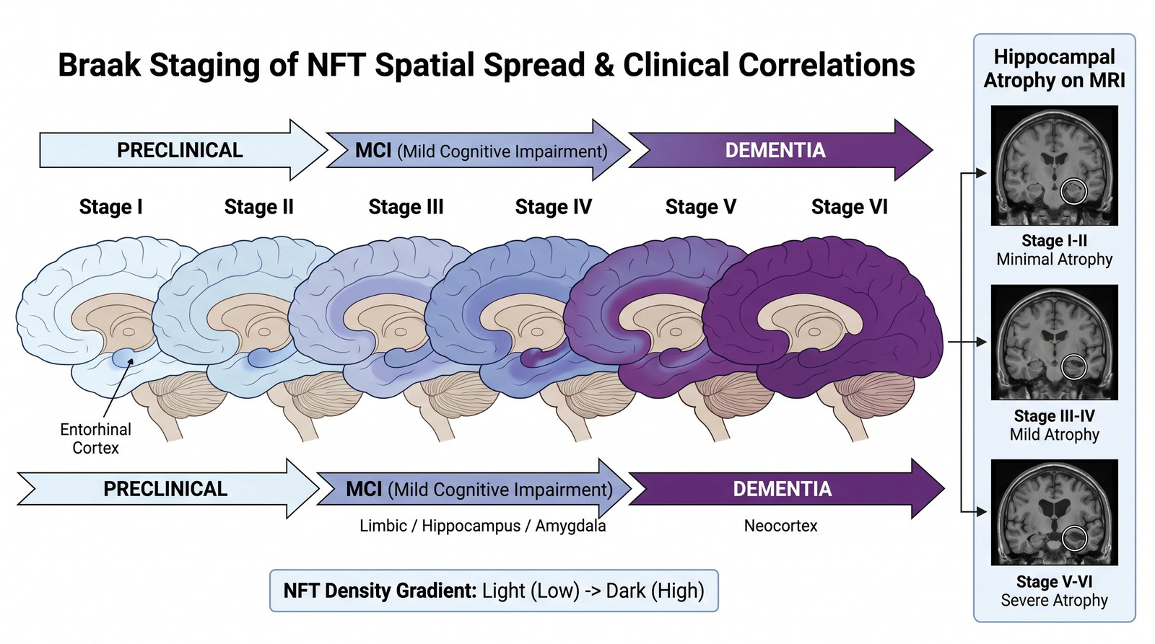
V · DISCUSSION AND NEXT STEPS
What the Results Mean
What it means for the field. For example, "Staging order is better predicted by connectivity than by distance, which supports network spread."
How it fits or clashes with prior work. For example, "It agrees with the tracer studies but disagrees with the proximity model derived from rodent injections."
The limitation a reviewer raises first. For example, "Post-mortem cross-section only — spread is inferred, not observed."
Need a diagram like this? Describe it and create one in seconds at SciFig.
Notes:
💡 What the results mean beyond this project, and the limitation that matters most.
🖼 This example figure was generated with SciFig — see the prompt at scifig.ai/go/sldb-prm
Template by SciFig
More free presentation templates for conferences, lab meetings, journal clubs and thesis defenses: scifig.ai/go/sldb-mor

Slide 16
V · DISCUSSION AND NEXT STEPS
Remaining Questions and Next Steps
Questions still open
What comes next
The question this work opened up. For example, "Does the partial rescue mean a second regulator is involved?"
The result that would change the interpretation if it did not hold.
The assumption the whole model still rests on.
The experiment that would answer it. For example, "A double knockout with the candidate regulator, on the same time-course."
What it would take to run. For example, "Two months of scope time and access to the primary tissue bank."
What would have to be true before scaling this up.
Notes:
💡 The question this opened, and what it would take to answer it.
Template by SciFig
More free presentation templates for conferences, lab meetings, journal clubs and thesis defenses: scifig.ai/go/sldb-mor

Slide 17
Publications and Conference Output
1
Peer-reviewed article — journal, year, and your author position. For example, "First author, Journal Name, 2026."
2
Manuscript under review or in preparation — state the status honestly. For example, "Under review at Journal Name since March 2026."
3
Conference talks and posters. For example, "Poster, AAIC 2026, London."
4
Datasets, code or protocols you released. For example, "Staging pipeline archived at doi.org/10.0000/example."
Notes:
💡 Published, under review, presented, and released — with the status of each.
Template by SciFig
More free presentation templates for conferences, lab meetings, journal clubs and thesis defenses: scifig.ai/go/sldb-mor

Slide 18
THANK YOU
Committee and Acknowledgments
Committee and supervision
Lab, funding and facilities
Name — supervisor
Name — co-supervisor
Name — committee chair
Name — internal examiner
Name — external examiner
Name
Name — lab members
Name — histology core
Name — imaging facility
NIH Grant No. XYZ12345
Doctoral fellowship, Year-Year
your.email@institution.edu
Insert a picture of your lab or cohort here
Name of Institution or University
QR code to your thesis, publications or dataset
Make a QR code free
Notes:
💡 Committee, supervision, lab, funding, and contact details.
Template by SciFig
More free presentation templates for conferences, lab meetings, journal clubs and thesis defenses: scifig.ai/go/sldb-mor

Slide 19
Supplementary Resources
The next slides hold ready-made figures and icons you can drop straight into this deck — and a link to the rest.
Notes:
💡 A divider: everything after this is reference material, not the talk.
Template by SciFig
More free presentation templates for conferences, lab meetings, journal clubs and thesis defenses: scifig.ai/go/sldb-mor

Slide 20
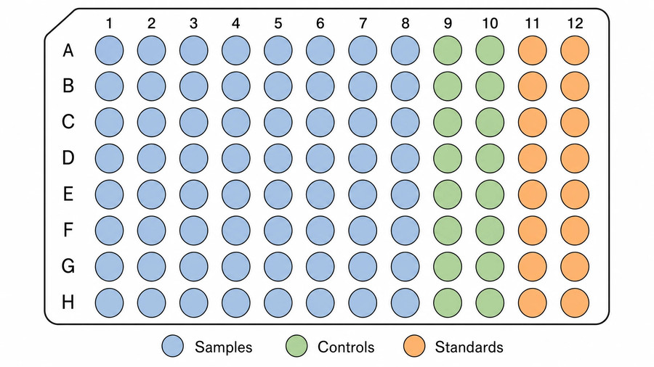
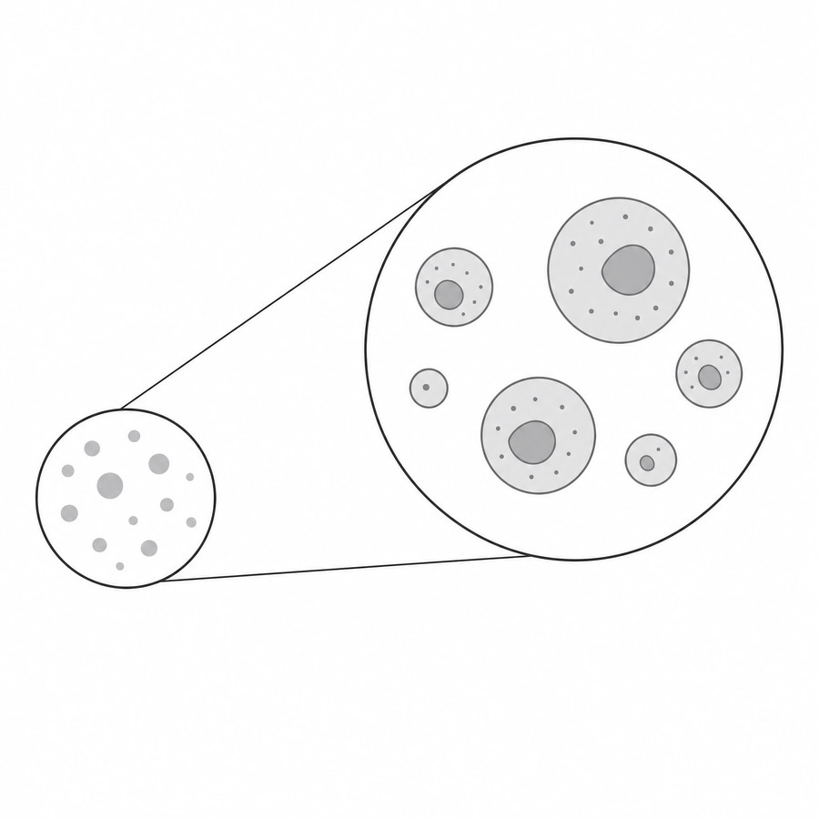
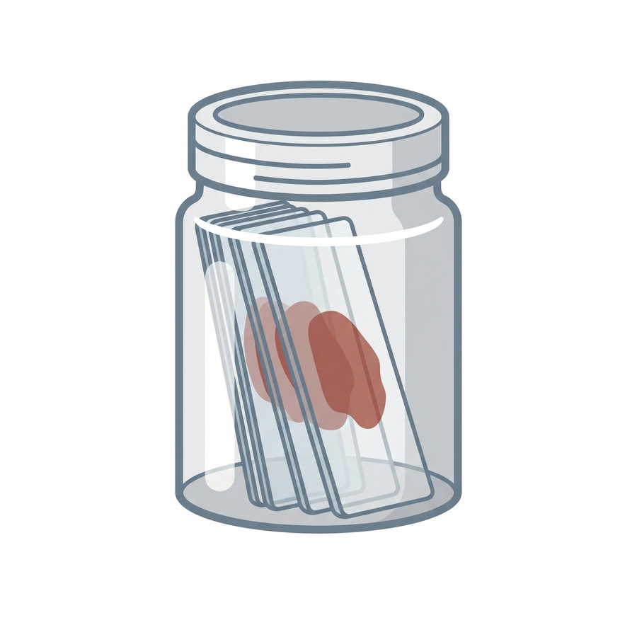
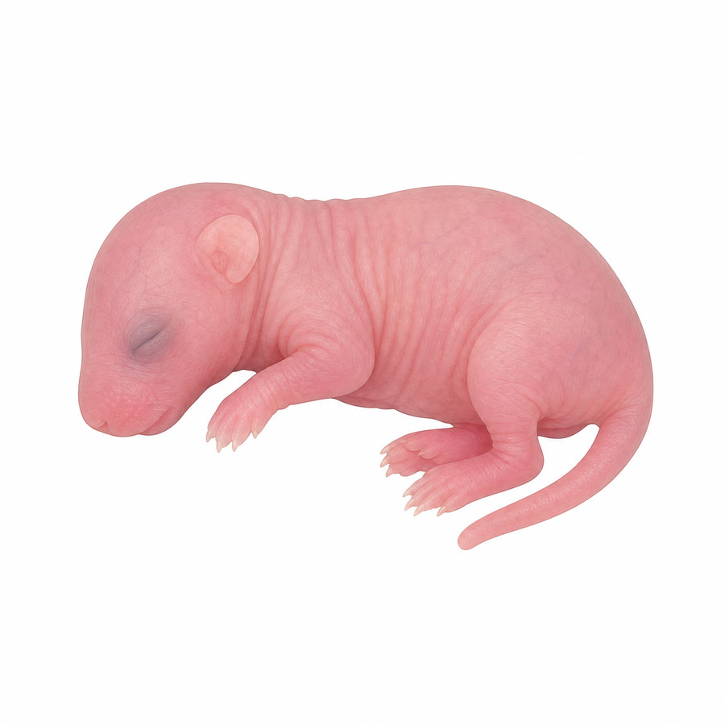
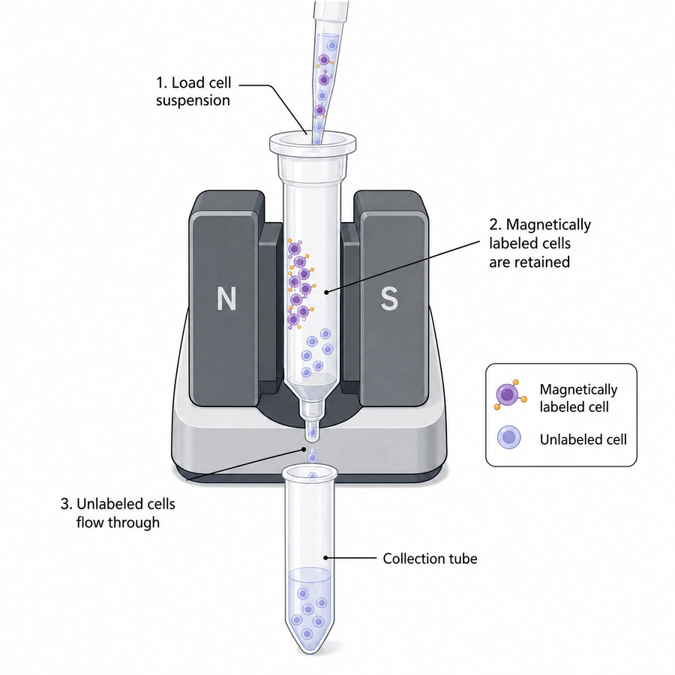
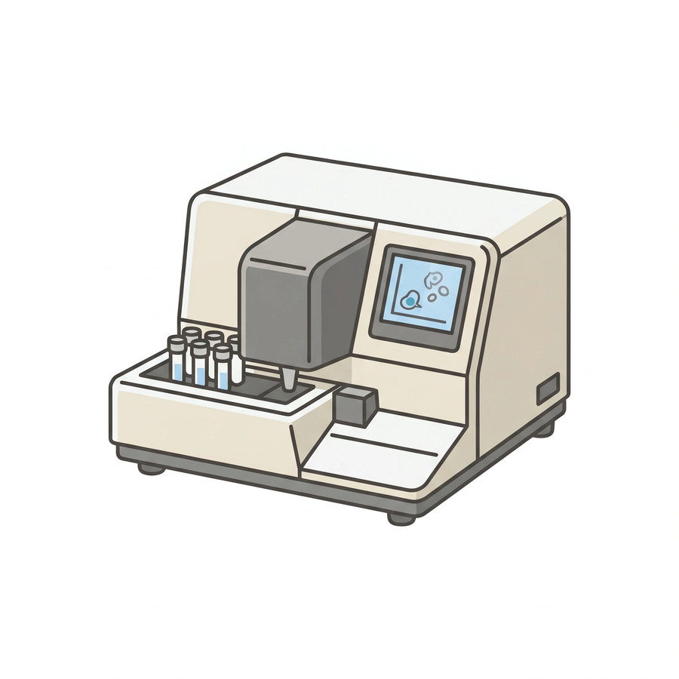
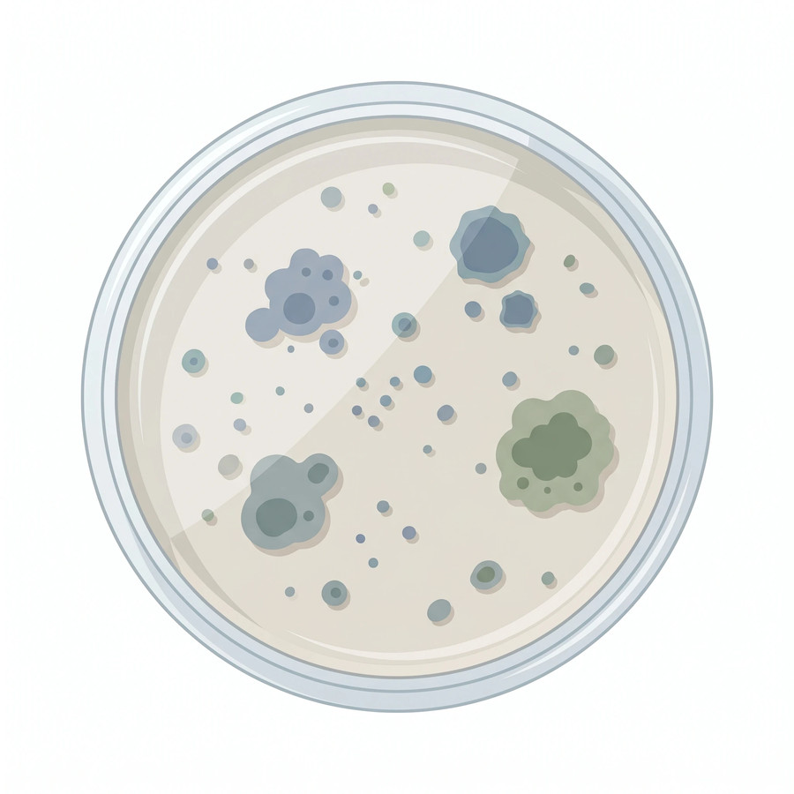
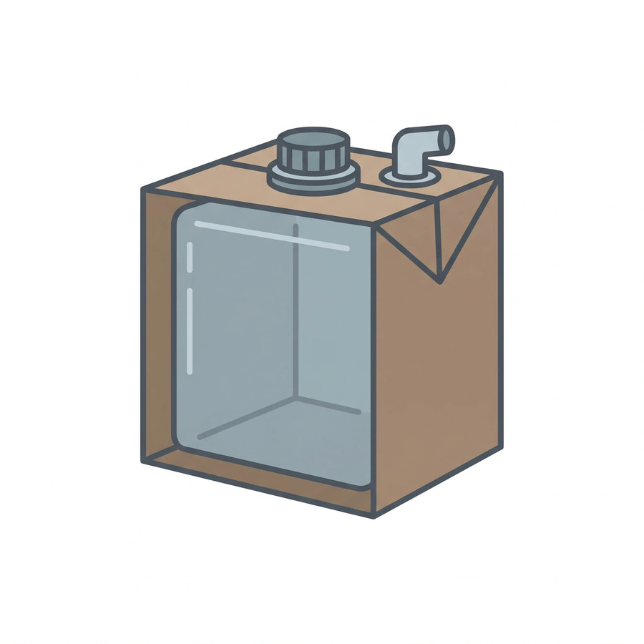
Resources: Lab Equipment and Consumables
Use these resources to level up your presentation
96-well plate
Zoomed callout
Coplin jar
Lab mouse
Magnetic cell separator
Imaging flow cytometer
Petri dish
Cubitainer
Browse free scientific icons at SciFig — or generate any figure free.
Notes:
💡 Ready-made assets — swap any of these straight into your slides.
Template by SciFig
More free presentation templates for conferences, lab meetings, journal clubs and thesis defenses: scifig.ai/go/sldb-mor

Slide 21
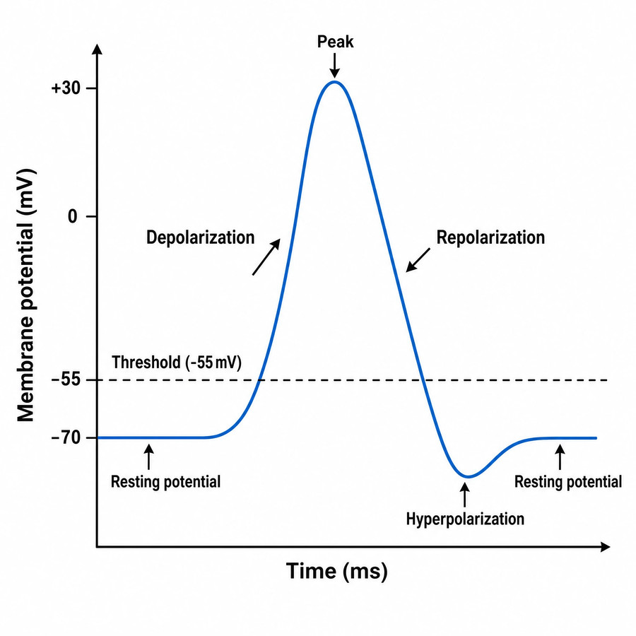
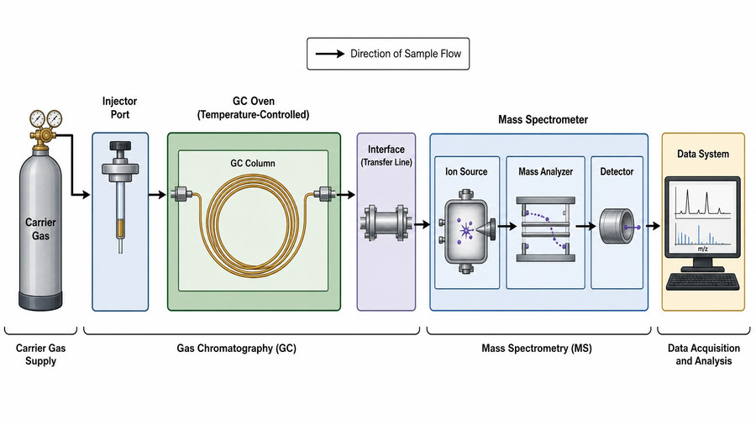
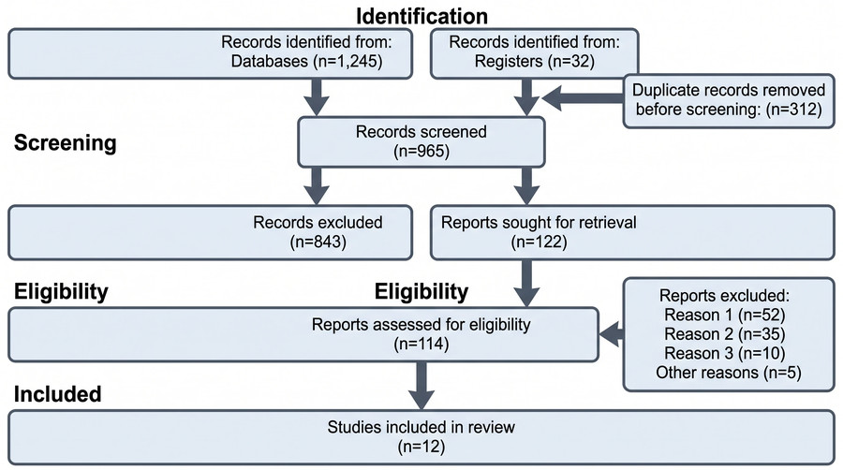
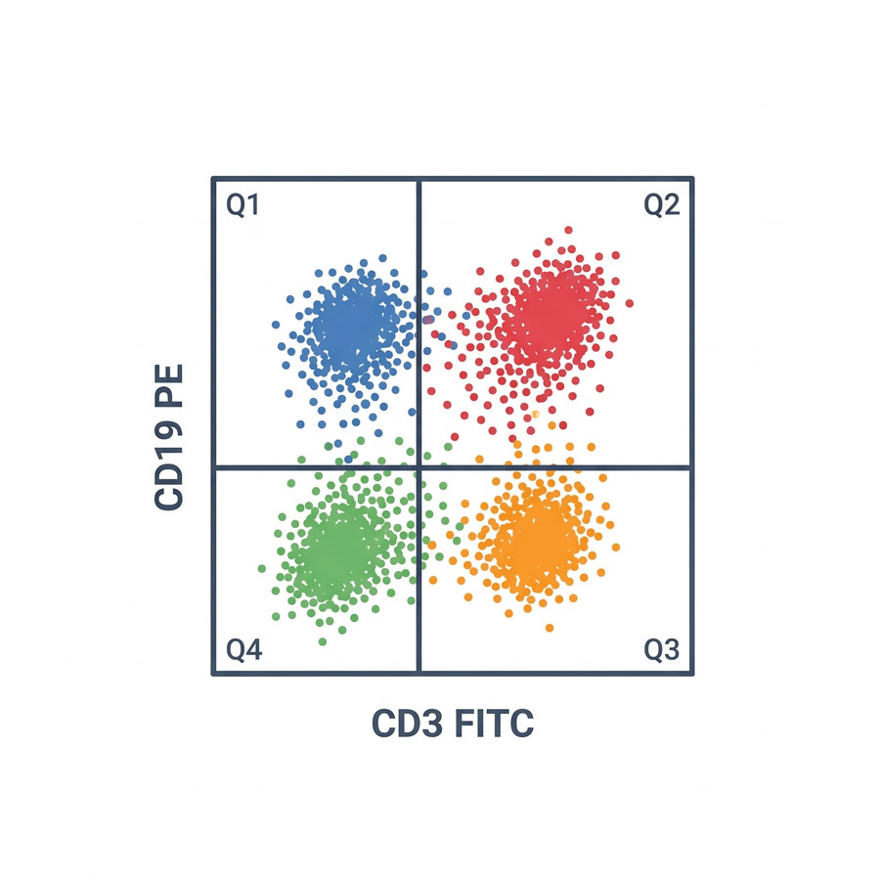
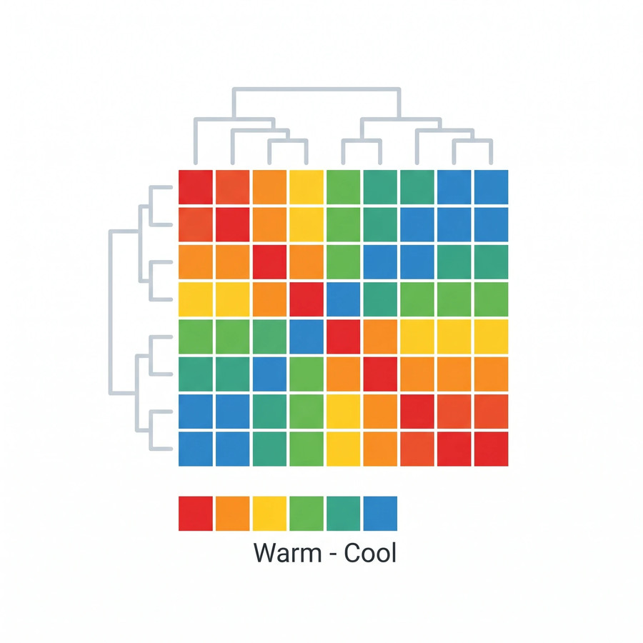
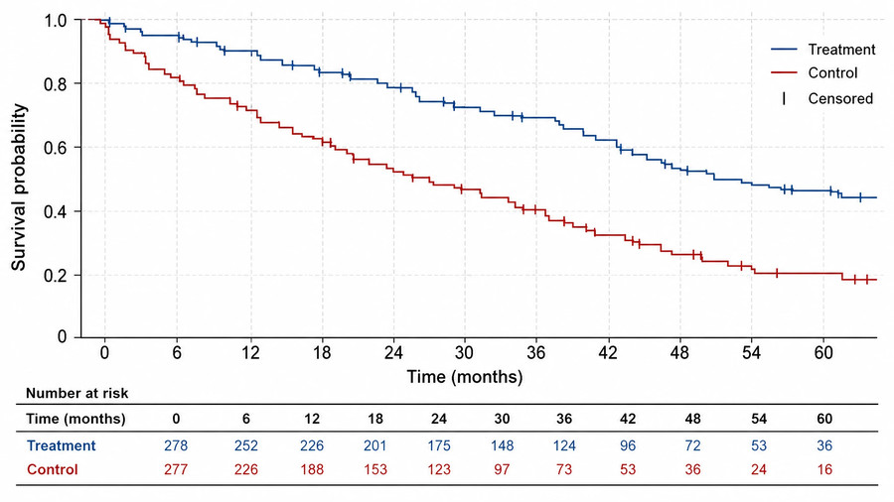
Resources: Data and Analysis Figures
Use these resources to level up your presentation
Action potential
GC-MS schematic
PRISMA flow diagram
Flow cytometry plot
Heat map
Kaplan-Meier curve
Browse free figure templates at SciFig — or generate any figure free.
Notes:
💡 Chart and workflow figures you can adapt to your own numbers.
Template by SciFig
More free presentation templates for conferences, lab meetings, journal clubs and thesis defenses: scifig.ai/go/sldb-mor

Slide 22
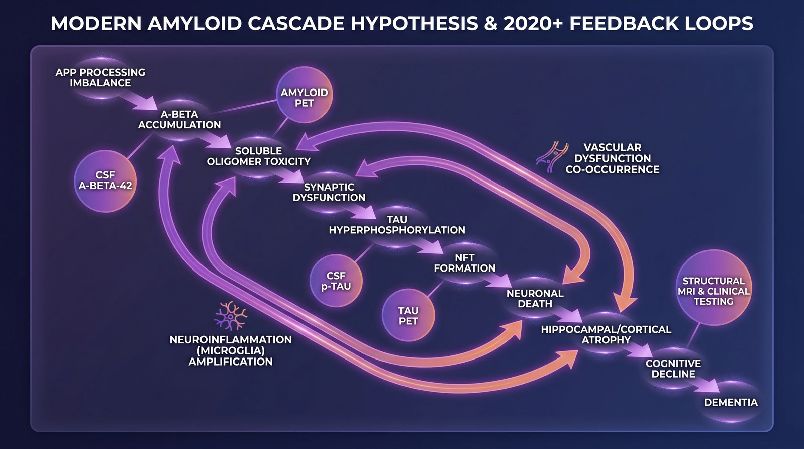
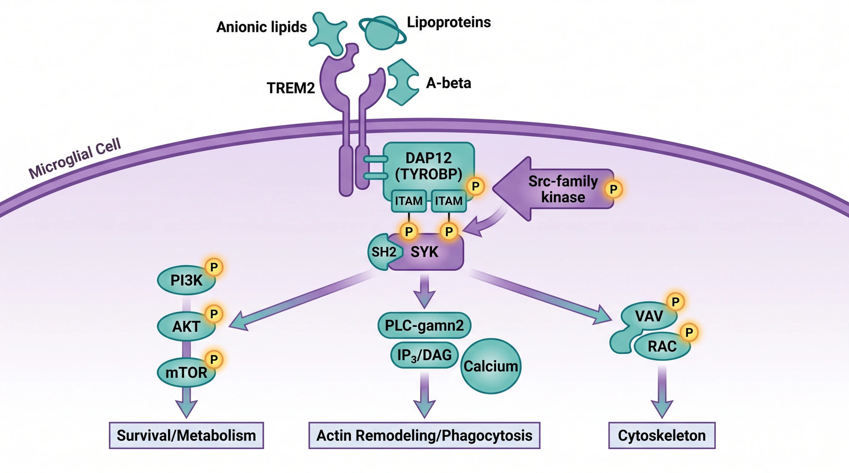
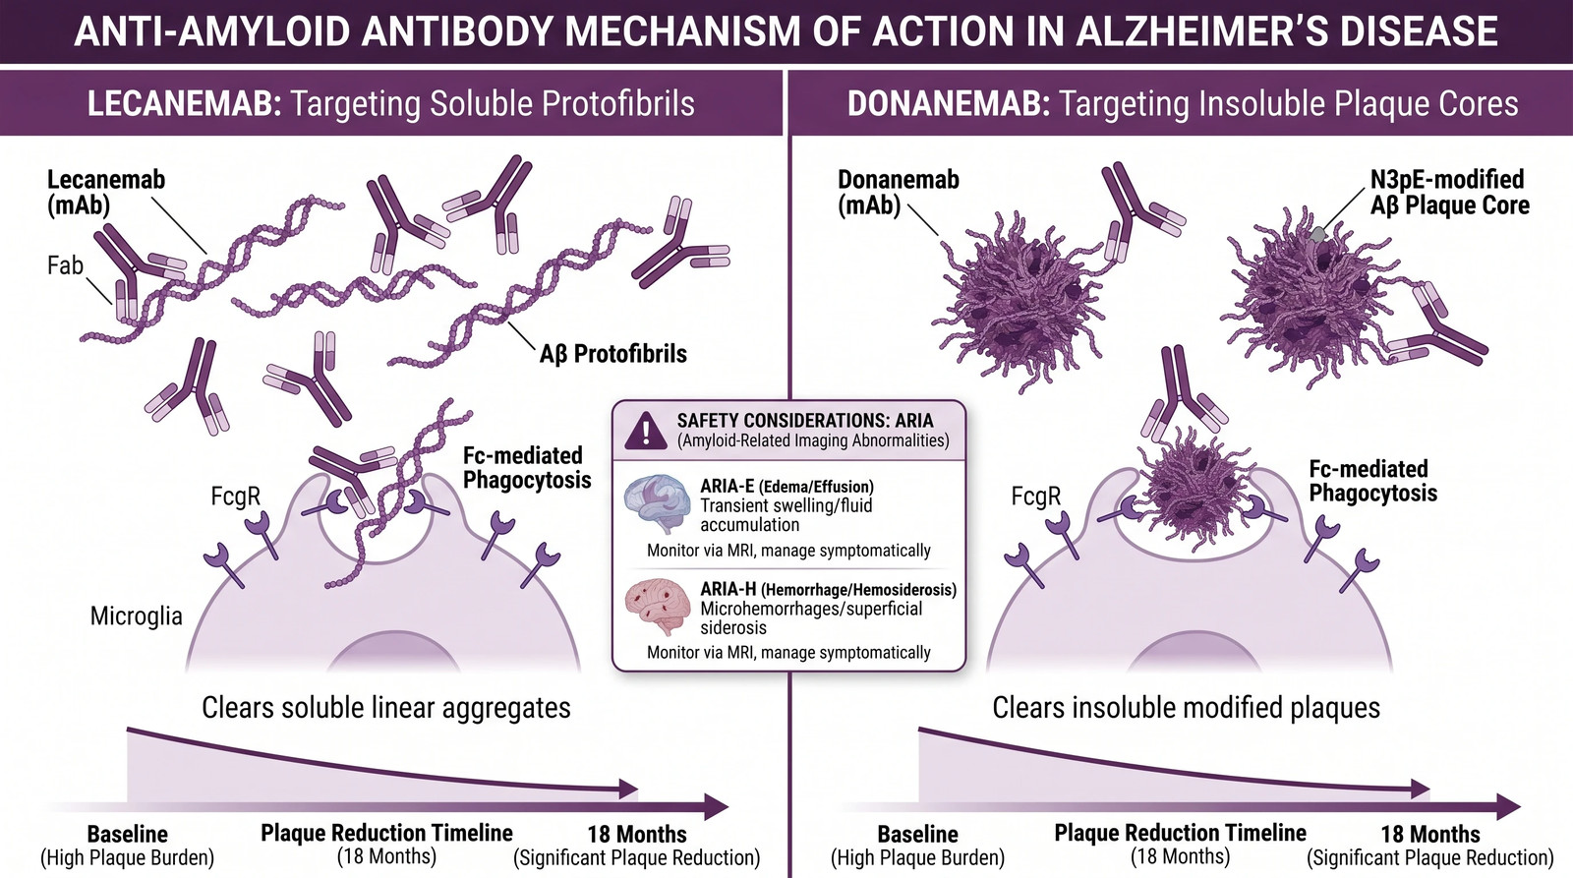
Resources: Neurodegeneration Figures
Use these resources to level up your presentation
Browse the full figure gallery at SciFig — or generate any figure free.
Notes:
💡 Field-specific figures — every one of these was generated from a prompt.
Template by SciFig
More free presentation templates for conferences, lab meetings, journal clubs and thesis defenses: scifig.ai/go/sldb-mor

