Slide 1
Name of Institution or University
Journal Club: CD19 Antigen Escape After CAR-T Therapy in Relapsed Large B-Cell Lymphoma
Your name here
Journal club, lab or course
Your title or role here
Date of session
Notes:
💡 The paper is the subject of this talk — name it, and name the occasion.
Template by SciFig
More free presentation templates for conferences, lab meetings, journal clubs and thesis defenses: scifig.ai/go/sljm-mor

Slide 2
Name of Institution or University
Journal Club: CD19 Antigen Escape After CAR-T Therapy in Relapsed Large B-Cell Lymphoma
Want a different color palette? One change recolors the whole deck.
PowerPoint — Design → Variants → Colors → Customize Colors. Fonts: Design → Variants → Fonts.
Google Slides — Slide → Edit theme → Colors.
Need more detail? Read the full recoloring guide.
Delete this slide when you are done.
Your name here
Journal club, lab or course
Your title or role here
Date of session
Notes:
💡 A working copy of the title slide — recolor the deck here, then delete this slide.
Template by SciFig
More free presentation templates for conferences, lab meetings, journal clubs and thesis defenses: scifig.ai/go/sljm-mor

Slide 3
Why This Paper
1
It changes how we read a result we see in our own work. For example, "We have been calling late relapse T cell exhaustion — this paper says it may be antigen loss."
2
It uses a method we are considering adopting. For example, "Their single-cell antigen assay is the one we costed out last quarter."
3
Its conclusion conflicts with something we discussed before. For example, "It contradicts the 2024 cohort study we read in March."
Notes:
💡 One honest sentence on why this paper is worth the room's hour.
Template by SciFig
More free presentation templates for conferences, lab meetings, journal clubs and thesis defenses: scifig.ai/go/sljm-mor

Slide 4
I
Background and open question
II
What the paper claims
Roadmap
III
Methods and key figures
IV
Strengths and limitations
V
What it means for us
Notes:
💡 Where the summary ends and the critique begins.
Template by SciFig
More free presentation templates for conferences, lab meetings, journal clubs and thesis defenses: scifig.ai/go/sljm-mor

Slide 5
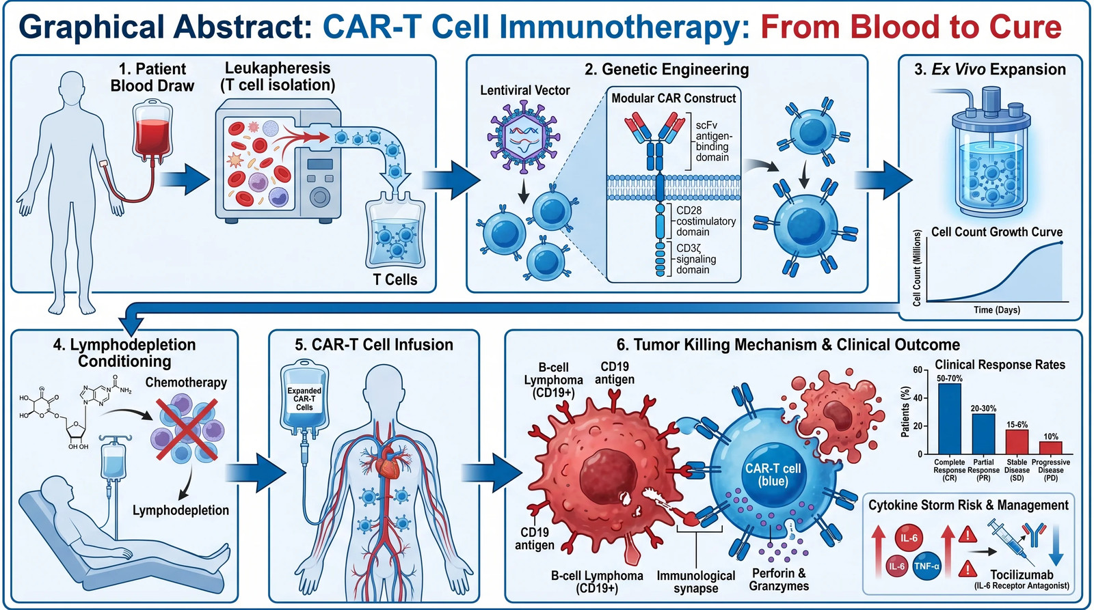
I · BACKGROUND AND OPEN QUESTION
Field Background
CAR-T therapy redirects a patient's own T cells against a tumor antigen, and CD19 has been the primary target in B-cell malignancies.
Durable remission is achieved in only a subset of patients — roughly 40 percent at two years in the pivotal trials.
Give only the background needed to judge this paper's claim; if your lab already works here, two sentences is plenty.
Need a diagram like this? Describe it and create one in seconds at SciFig.
Notes:
💡 Just enough field context to judge the claim that follows.
🖼 This example figure was generated with SciFig — see the prompt at scifig.ai/go/sljm-prm
Template by SciFig
More free presentation templates for conferences, lab meetings, journal clubs and thesis defenses: scifig.ai/go/sljm-mor

Slide 6
I · BACKGROUND AND OPEN QUESTION
The Open Question
1
Why do some patients relapse despite an initial complete response?
2
Is relapse driven by loss of the target antigen or by T cell exhaustion? The two mechanisms imply opposite clinical responses.
3
Frame the question so the room can predict what evidence would settle it — then they can judge for themselves whether the paper delivers.
Notes:
💡 The open question, and what evidence would settle it.
Template by SciFig
More free presentation templates for conferences, lab meetings, journal clubs and thesis defenses: scifig.ai/go/sljm-mor

Slide 7
II · WHAT THE PAPER CLAIMS
The Paper's Central Claim
State the paper's main claim in one sentence, in your own words.
A worked example: "Most late relapses in this cohort carry CD19-negative disease, and antigen loss precedes any measurable loss of T cell function."
Reword it rather than quoting the abstract — rewording is the test of whether you understood it.
Notes:
💡 The paper's claim in one sentence, in your own words.
Template by SciFig
More free presentation templates for conferences, lab meetings, journal clubs and thesis defenses: scifig.ai/go/sljm-mor

Slide 8
II · WHAT THE PAPER CLAIMS
Study Design at a Glance
Redraw the study design as one diagram.
Cohorts, timepoints, and what was measured.
No figure fits your data? Describe it and create one in seconds at SciFig.
Notes:
💡 The study reduced to one diagram: cohorts, timepoints, readouts.
Template by SciFig
More free presentation templates for conferences, lab meetings, journal clubs and thesis defenses: scifig.ai/go/sljm-mor

Slide 9
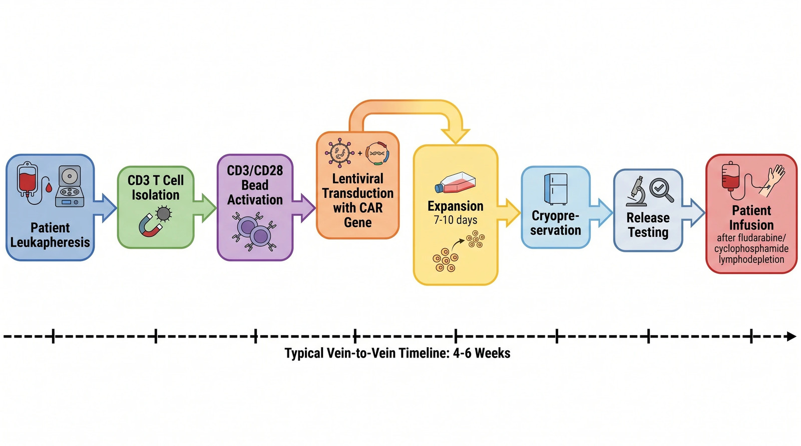
III · METHODS AND KEY FIGURES
Key Methods
Cohort size, inclusion criteria, follow-up window. For example, "n = 84 adults, all post-second-line, median follow-up 26 months."
How the key variable was measured. For example, "Antigen loss was defined by flow cytometry on the relapse biopsy, not by sequencing."
What served as the comparison group. For example, "Patients in ongoing remission at the same timepoint."
Need a diagram like this? Describe it and create one in seconds at SciFig.
Notes:
💡 The one methodological choice the whole conclusion rests on.
🖼 This example figure was generated with SciFig — see the prompt at scifig.ai/go/sljm-prm
Template by SciFig
More free presentation templates for conferences, lab meetings, journal clubs and thesis defenses: scifig.ai/go/sljm-mor

Slide 10
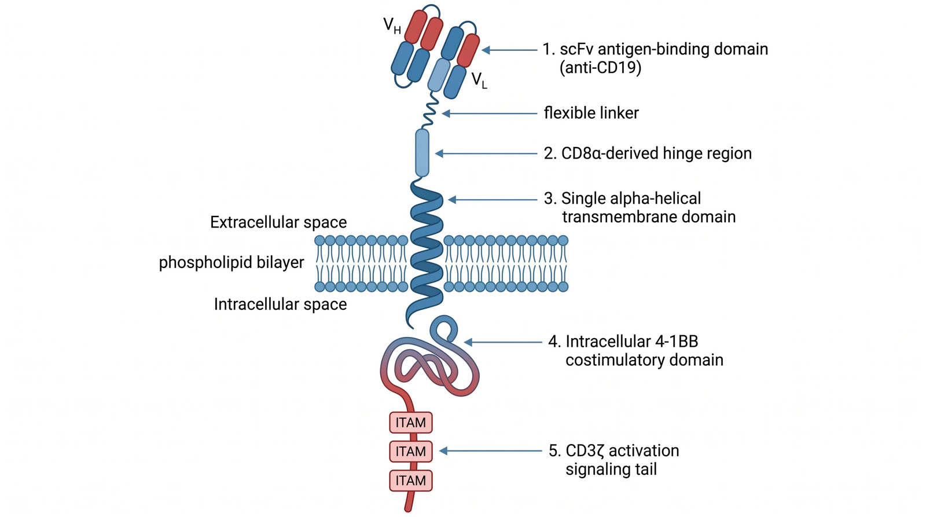
III · METHODS AND KEY FIGURES
Figure 1 — What It Shows
Say what is on each axis and what one data point represents before you say what the figure means.
Name the comparison the figure is actually making. For example, "Relapsed versus remission, not treated versus untreated."
Check whether the effect is as large as the layout makes it look — a truncated axis is the most common way a panel oversells.
Need a diagram like this? Describe it and create one in seconds at SciFig.
Notes:
💡 What the figure plots, and what comparison it actually makes.
🖼 This example figure was generated with SciFig — see the prompt at scifig.ai/go/sljm-prm
Template by SciFig
More free presentation templates for conferences, lab meetings, journal clubs and thesis defenses: scifig.ai/go/sljm-mor

Slide 11
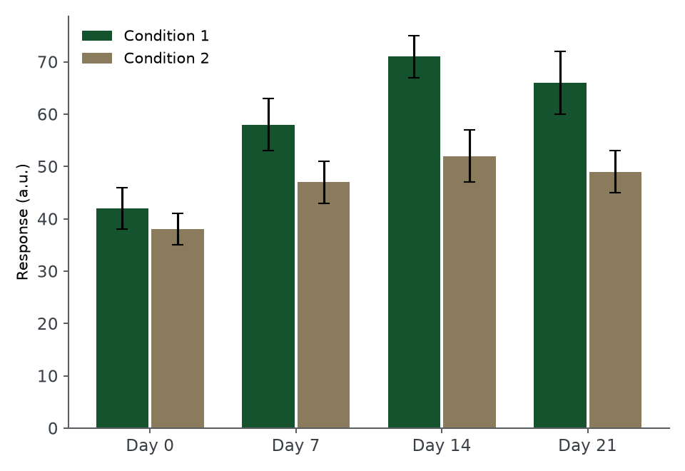
III · METHODS AND KEY FIGURES
Figure 2 — The Central Evidence
This is the figure the paper's claim rests on — give it the most time.
Ask the counterfactual out loud: "What would this panel look like if the authors were wrong?"
Check the sample size in each group against the legend. For example, "n = 11 in the CD19-negative arm, which is where the confidence interval widens."
Describe this figure in one line: what is plotted, and what it shows.
Notes:
💡 The panel the paper's whole claim rests on.
🖼 This example figure was generated with SciFig — see the prompt at scifig.ai/go/sljm-prm
Template by SciFig
More free presentation templates for conferences, lab meetings, journal clubs and thesis defenses: scifig.ai/go/sljm-mor

Slide 12
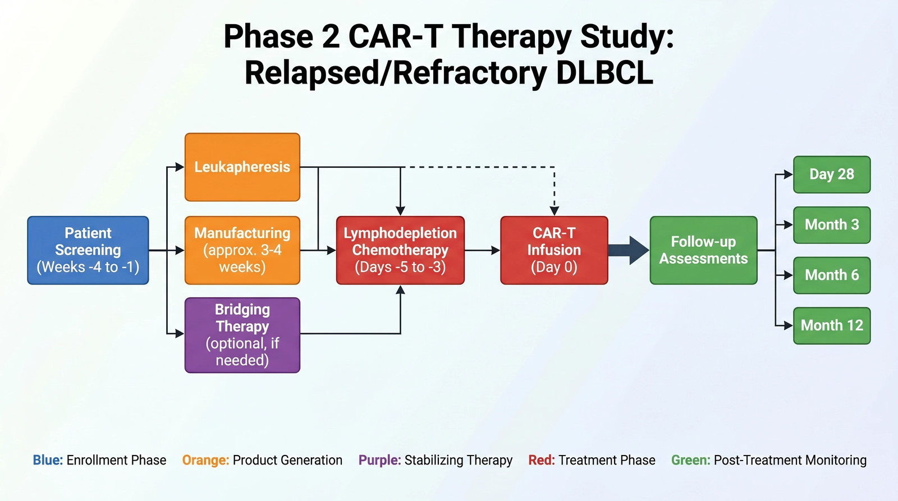
III · METHODS AND KEY FIGURES
Figure 3 — The Supporting Result
What this adds beyond Figure 2 — and whether it is an independent test or the same data re-cut.
Note any panel that appears only in the supplement, and ask why. For example, "The negative control cohort is supplementary only."
Supporting figures are where re-analyzed data usually hides.
Need a diagram like this? Describe it and create one in seconds at SciFig.
Notes:
💡 Whether this is an independent test or the same data re-cut.
🖼 This example figure was generated with SciFig — see the prompt at scifig.ai/go/sljm-prm
Template by SciFig
More free presentation templates for conferences, lab meetings, journal clubs and thesis defenses: scifig.ai/go/sljm-mor

Slide 13
IV · STRENGTHS AND LIMITATIONS
Key Findings
Claim | Evidence | How convinced are we
Late relapse is CD19-negative | Figure 2 | Convinced
Antigen loss precedes exhaustion | Figure 3 | Partly
Mechanism is splice-variant driven | Supplement | Not yet
Effect holds across prior lines | Table S2 | Unclear
Notes:
💡 Each claim, its evidence, and how convinced you are by it.
Template by SciFig
More free presentation templates for conferences, lab meetings, journal clubs and thesis defenses: scifig.ai/go/sljm-mor

Slide 14
IV · STRENGTHS AND LIMITATIONS
What the Paper Does Well
1
What this does better than what came before. For example, "It is the first cohort with paired pre- and post-relapse biopsies."
2
The control that makes the result credible. For example, "Remission patients sampled at the matched timepoint."
3
What the authors made available. For example, "Flow gating strategy and analysis code are both in the supplement."
Notes:
💡 What this paper does better than what came before it.
Template by SciFig
More free presentation templates for conferences, lab meetings, journal clubs and thesis defenses: scifig.ai/go/sljm-mor

Slide 15
IV · STRENGTHS AND LIMITATIONS
Limitations and Critique
What the authors acknowledge
What we would add
Single-center cohort of 84 patients
Follow-up shorter than the late-relapse window
Flow sensitivity near the detection floor
The comparison group may not be matched for prior lines of therapy
Exhaustion is not directly measured — it is inferred by exclusion
The abstract states a mechanism the data only suggests
Notes:
💡 Limitations the authors state, and the ones they do not.
Template by SciFig
More free presentation templates for conferences, lab meetings, journal clubs and thesis defenses: scifig.ai/go/sljm-mor

Slide 16
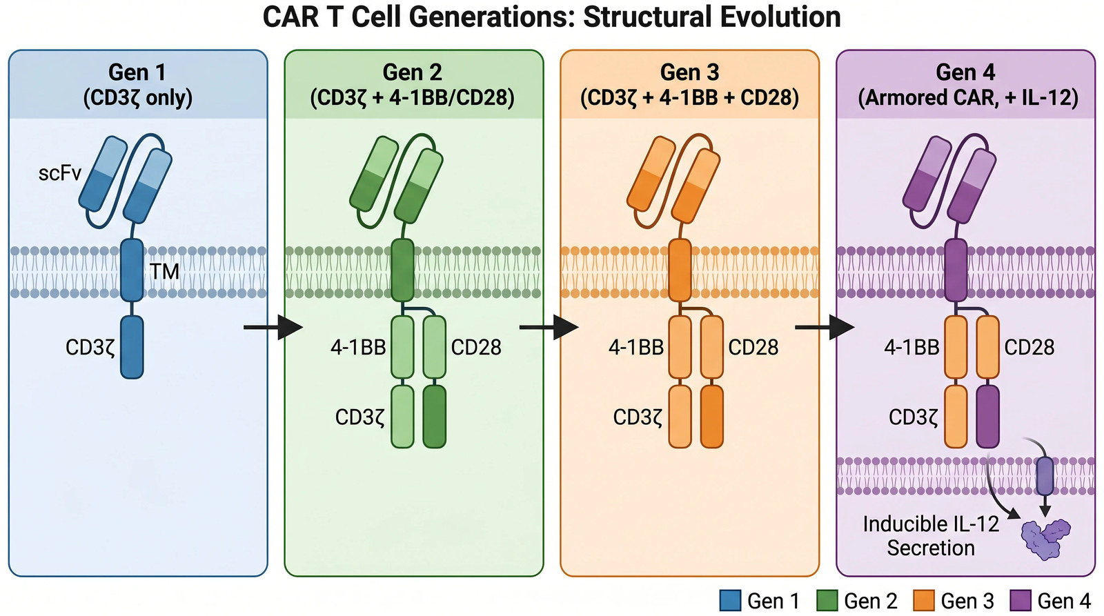
V · WHAT IT MEANS FOR US
Implications for the Field
What changes if this holds up. For example, "Antigen screening at relapse becomes routine rather than optional."
What it means for our own experiments. For example, "We should be genotyping the relapse samples we already have banked."
What would have to be shown before we act on it. For example, "Replication in a multi-center cohort."
Need a diagram like this? Describe it and create one in seconds at SciFig.
Notes:
💡 What changes if this holds, and what it means for your own work.
🖼 This example figure was generated with SciFig — see the prompt at scifig.ai/go/sljm-prm
Template by SciFig
More free presentation templates for conferences, lab meetings, journal clubs and thesis defenses: scifig.ai/go/sljm-mor

Slide 17
V · WHAT IT MEANS FOR US
Discussion Prompts
1
Would you have drawn the same conclusion from Figure 2?
2
What single experiment would most strengthen this paper?
3
Does this change how we interpret our own recent result?
4
Would you cite this as evidence, or as background?
Notes:
💡 The questions that open the discussion.
Template by SciFig
More free presentation templates for conferences, lab meetings, journal clubs and thesis defenses: scifig.ai/go/sljm-mor

Slide 18
References and Paper Link
1. The paper under discussion — Author, A. A., et al. (Year). Title of the article. Title of the Journal, volume(issue), pages. https://doi.org/10.0000/example
2. The prior study it builds on — Author, B. B., & Author, C. C. (Year). Title of the article. Title of the Journal, volume(issue), pages. https://doi.org/10.0000/example
3. The paper whose conclusion it contradicts — Author, D. D., et al. (Year). Title of the article. Title of the Journal, volume(issue), pages. https://doi.org/10.0000/example
QR code to the paper's DOI, supplementary data or your notes
Make a QR code free
Notes:
💡 Full citations for the paper and the two it sits between.
Template by SciFig
More free presentation templates for conferences, lab meetings, journal clubs and thesis defenses: scifig.ai/go/sljm-mor

Slide 19
Supplementary Resources
The next slides hold ready-made figures and icons you can drop straight into this deck — and a link to the rest.
Notes:
💡 A divider: everything after this is reference material, not the talk.
Template by SciFig
More free presentation templates for conferences, lab meetings, journal clubs and thesis defenses: scifig.ai/go/sljm-mor

Slide 20
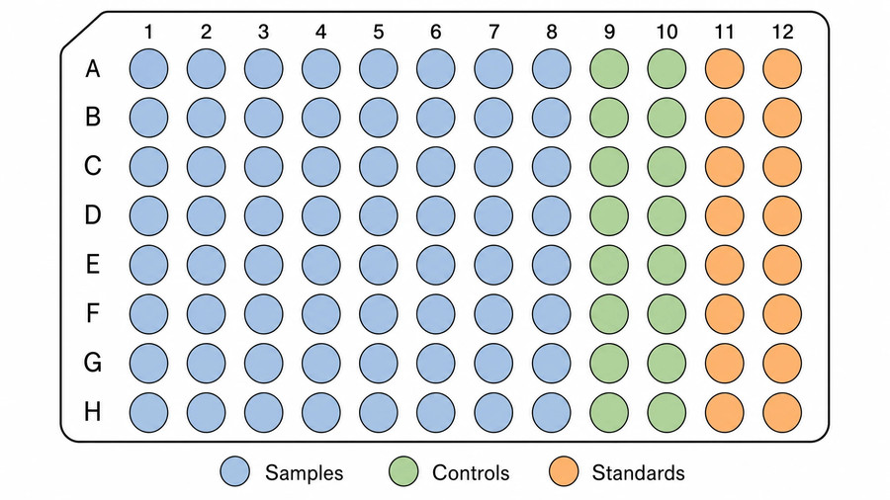
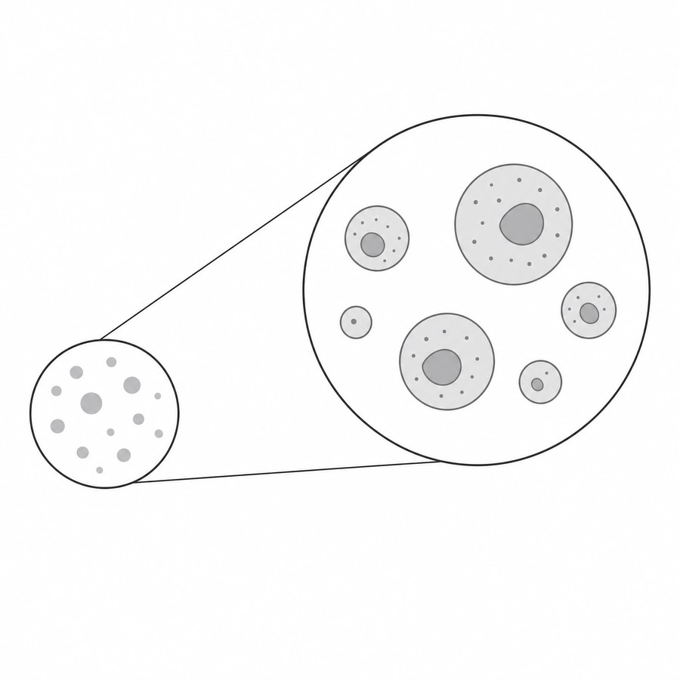
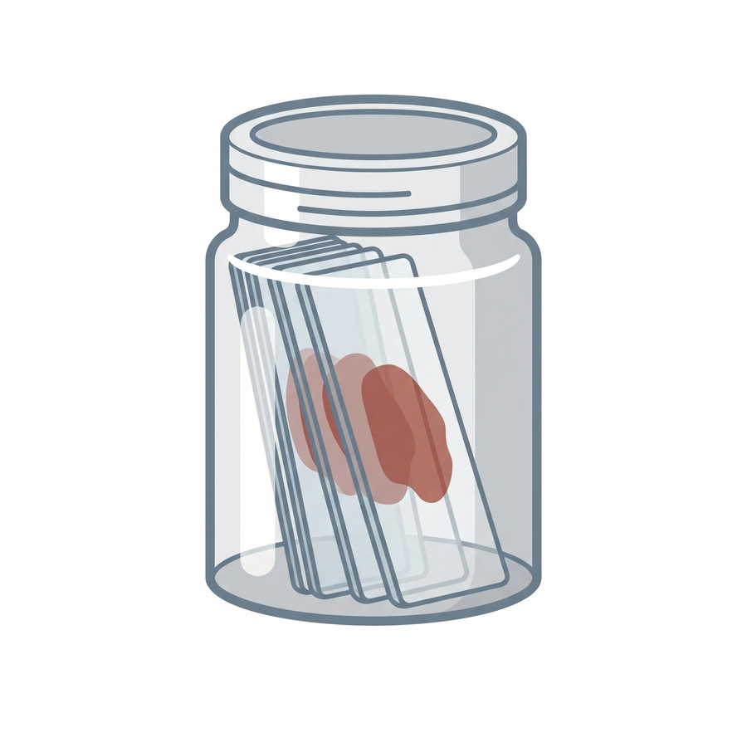
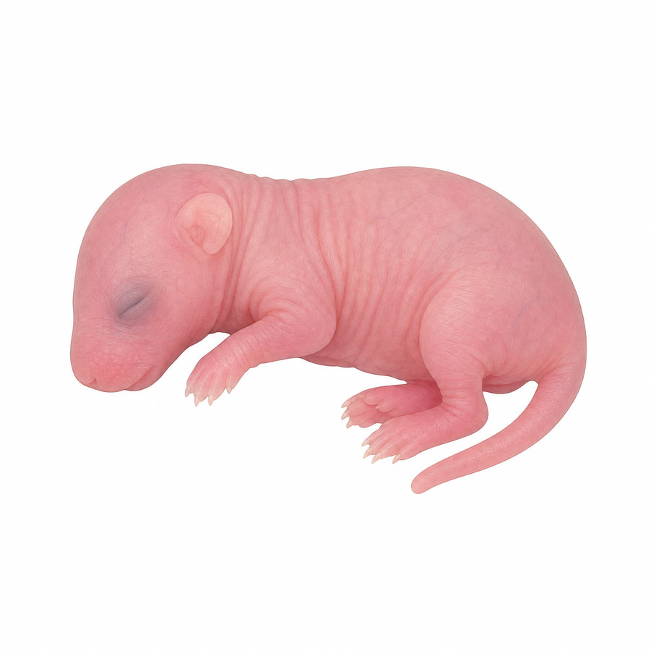
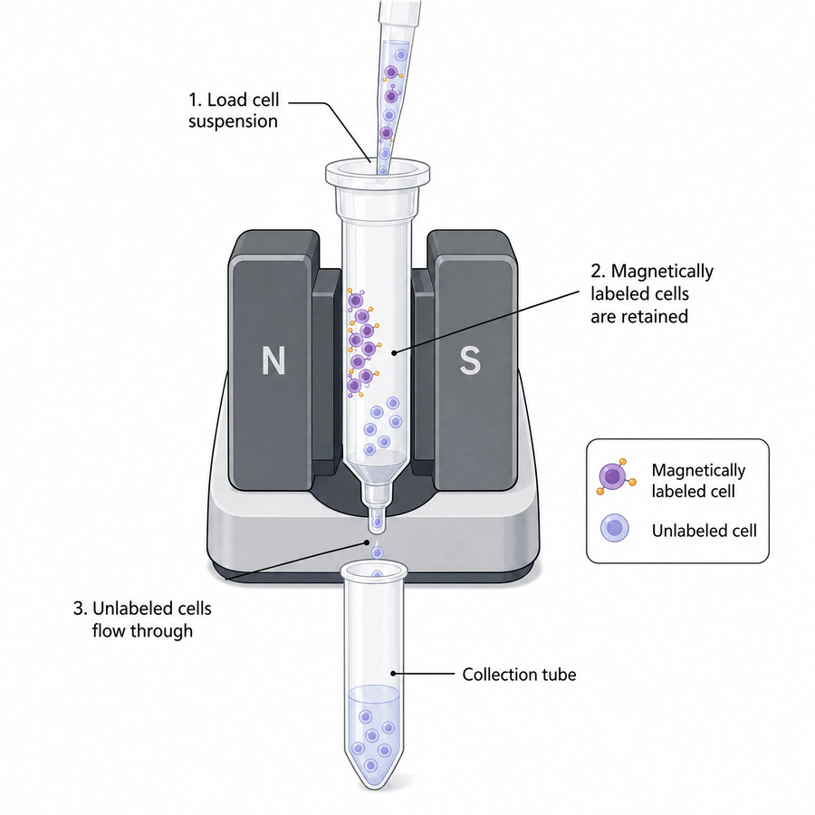
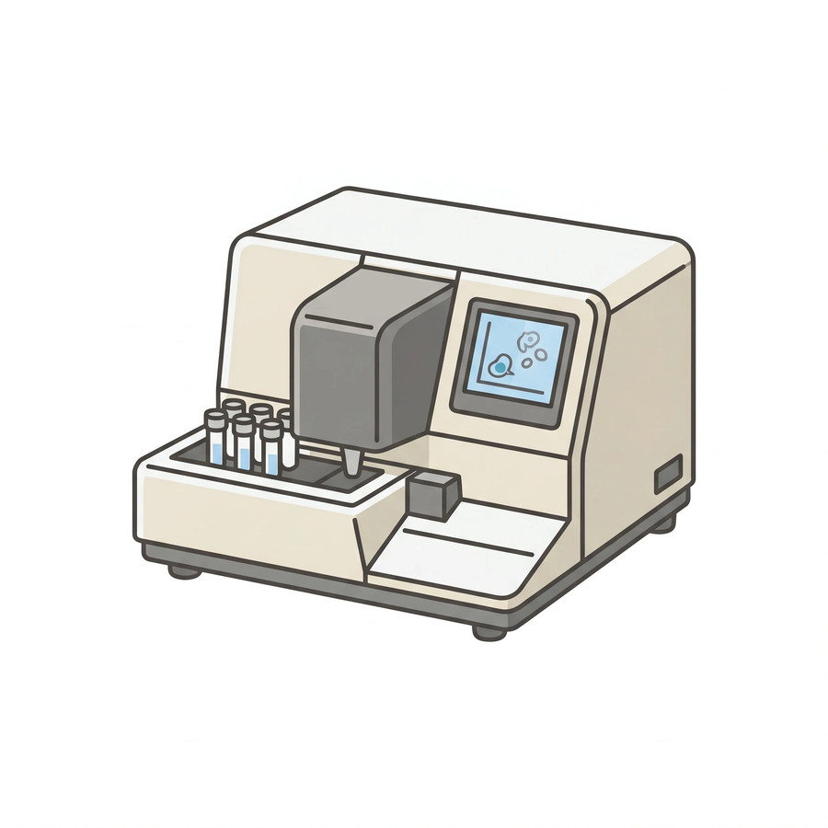
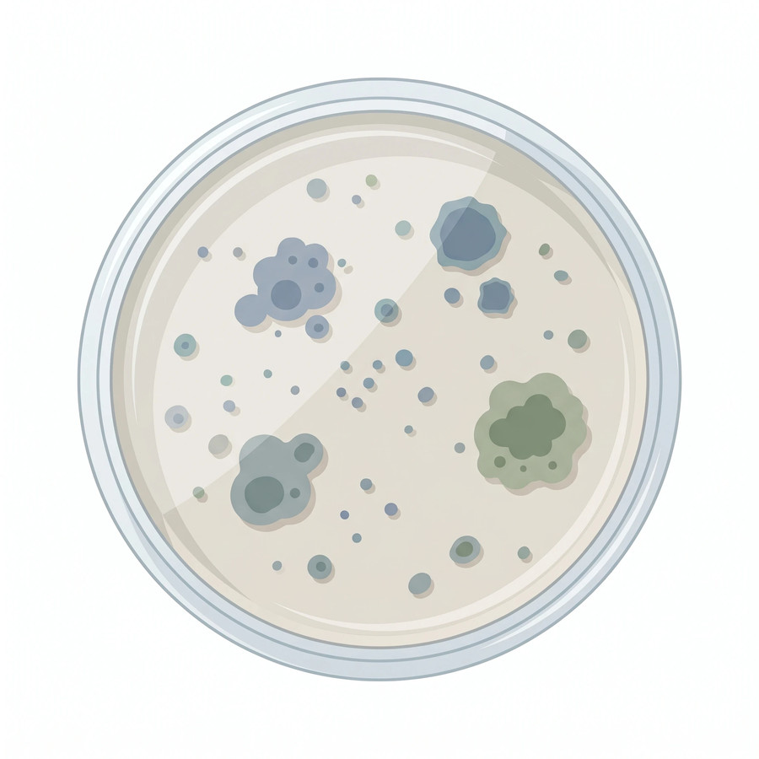

Resources: Lab Equipment and Consumables
Use these resources to level up your presentation
96-well plate
Zoomed callout
Coplin jar
Lab mouse
Magnetic cell separator
Imaging flow cytometer
Petri dish
Cubitainer
Browse free scientific icons at SciFig — or generate any figure free.
Notes:
💡 Ready-made assets — swap any of these straight into your slides.
Template by SciFig
More free presentation templates for conferences, lab meetings, journal clubs and thesis defenses: scifig.ai/go/sljm-mor

Slide 21
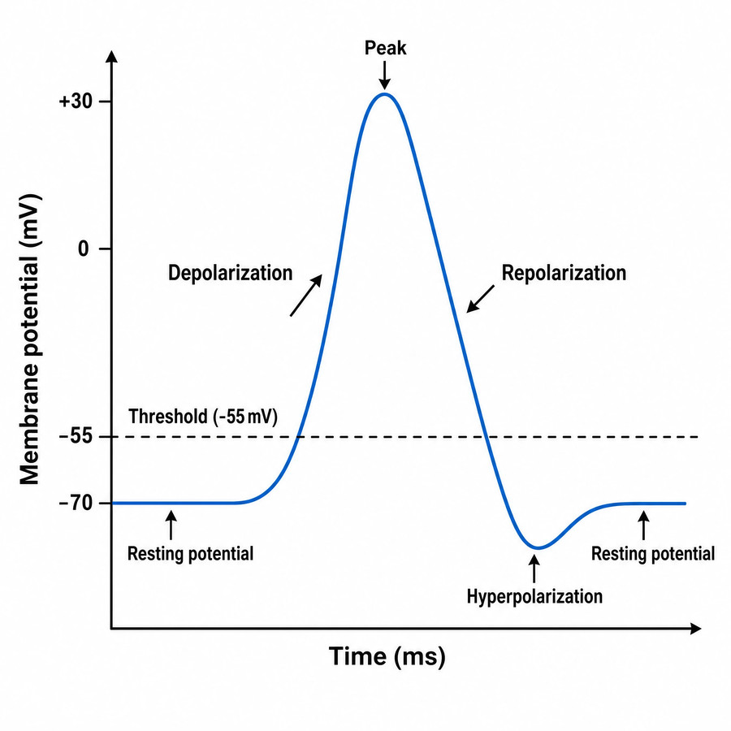
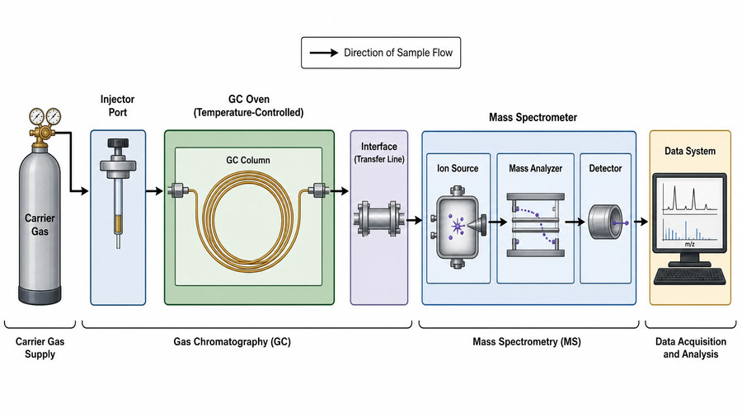
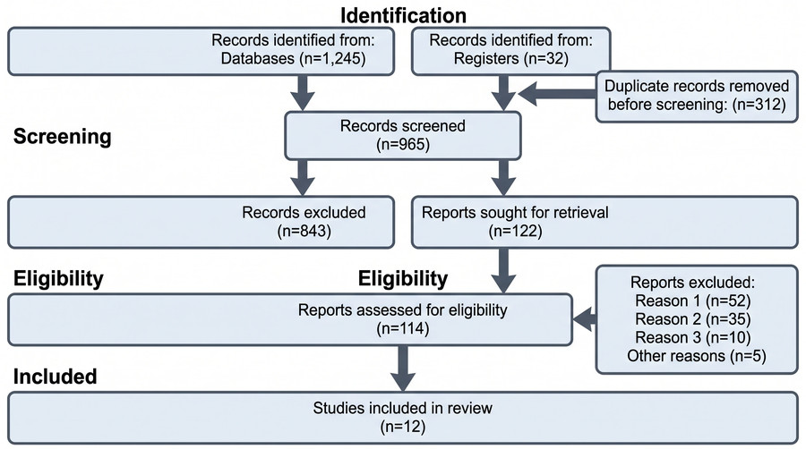
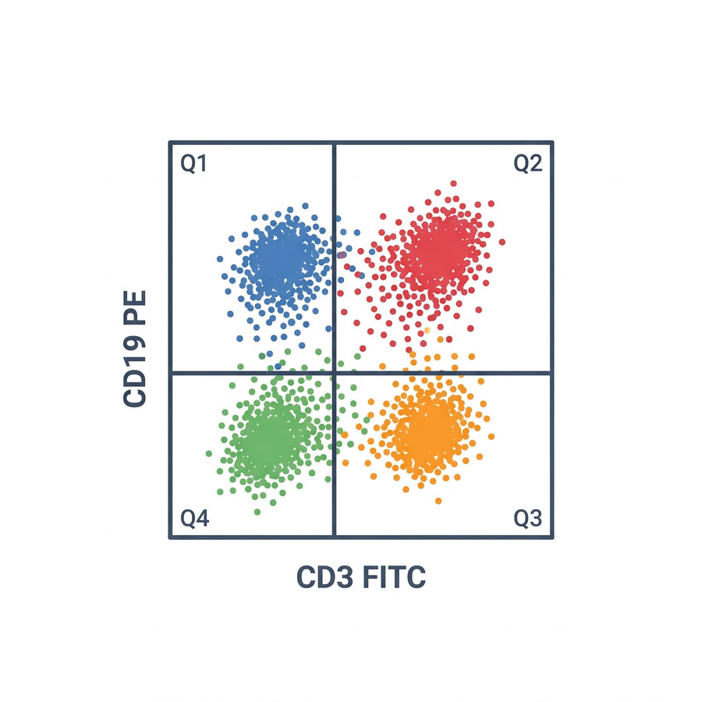
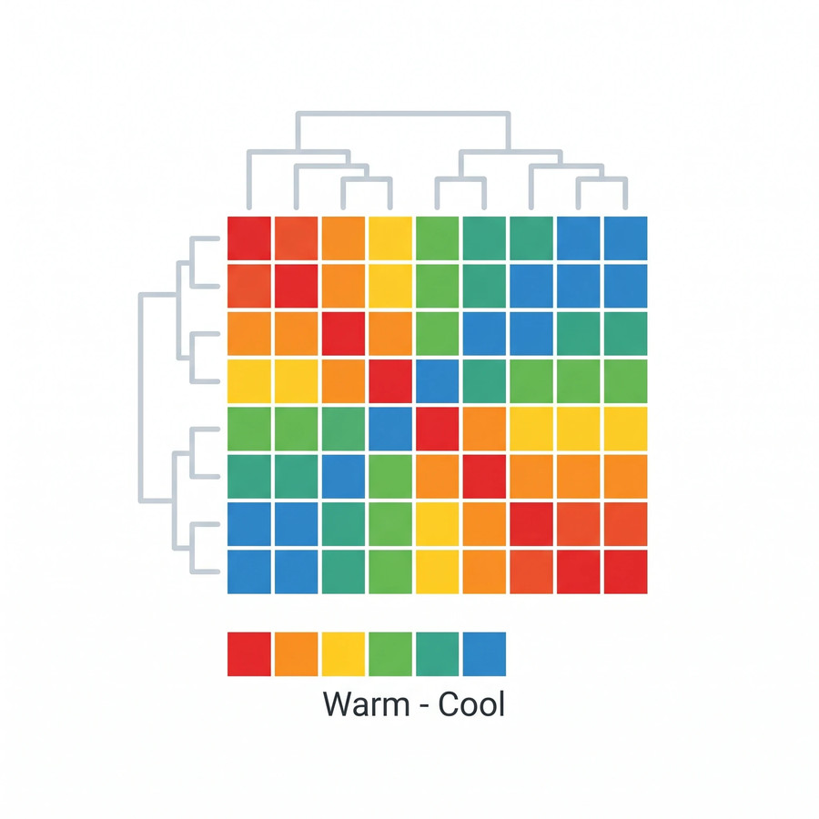
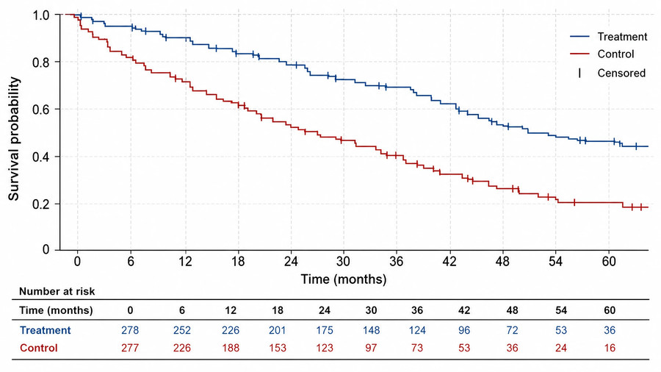
Resources: Data and Analysis Figures
Use these resources to level up your presentation
Action potential
GC-MS schematic
PRISMA flow diagram
Flow cytometry plot
Heat map
Kaplan-Meier curve
Browse free figure templates at SciFig — or generate any figure free.
Notes:
💡 Chart and workflow figures you can adapt to your own numbers.
Template by SciFig
More free presentation templates for conferences, lab meetings, journal clubs and thesis defenses: scifig.ai/go/sljm-mor

Slide 22
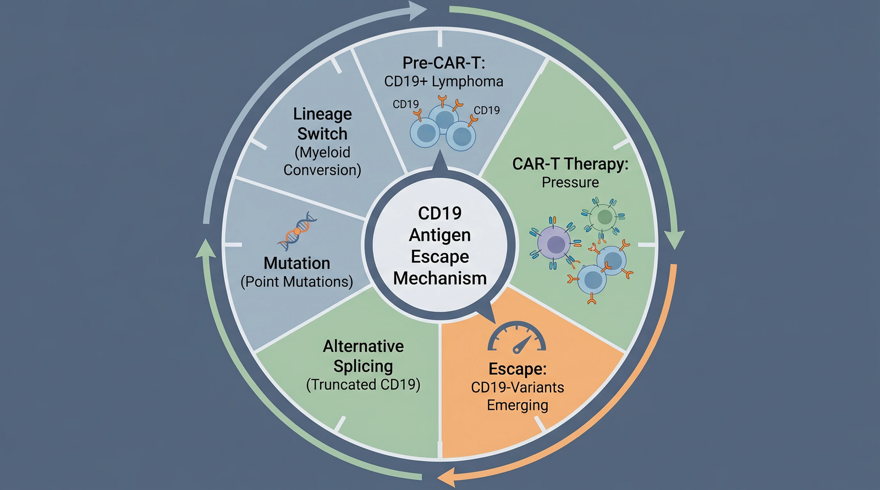
Resources: CAR-T and Immunotherapy Figures
Use these resources to level up your presentation
Browse the full figure gallery at SciFig — or generate any figure free.
Notes:
💡 Field-specific figures — every one of these was generated from a prompt.
Template by SciFig
More free presentation templates for conferences, lab meetings, journal clubs and thesis defenses: scifig.ai/go/sljm-mor

