Slide 1
Name of Institution or University
Conference Presentation for Tumor Immunology Research
Your name here
Name of conference or event
Your title or role here
Date of conference
Notes:
💡 The topic and the occasion, readable at a glance.
Template by SciFig
More free presentation templates for conferences, lab meetings, journal clubs and thesis defenses: scifig.ai/go/slcb-mor

Slide 2
Name of Institution or University
Conference Presentation for Tumor Immunology Research
Want a different color palette? One change recolors the whole deck.
PowerPoint — Design → Variants → Colors → Customize Colors. Fonts: Design → Variants → Fonts.
Google Slides — Slide → Edit theme → Colors.
Need more detail? Read the full recoloring guide.
Delete this slide when you are done.
Your name here
Name of conference or event
Your title or role here
Date of conference
Notes:
💡 A working copy of the title slide — recolor the deck here, then delete this slide.
Template by SciFig
More free presentation templates for conferences, lab meetings, journal clubs and thesis defenses: scifig.ai/go/slcb-mor

Slide 3
I
Research background
II
Hypothesis and objectives
Table of Contents
III
Methodology
IV
Results
V
Discussion and next steps
Notes:
💡 The shape of the talk: how many parts, and where the results sit.
Template by SciFig
More free presentation templates for conferences, lab meetings, journal clubs and thesis defenses: scifig.ai/go/slcb-mor

Slide 4
Funding and Disclosures
1
Funding sources — National Institutes of Health (NIH), Grant No. XYZ12345; National Science Foundation (NSF), Grant No. ABC67890
2
Conflicts of interest — Dr. A. Researcher holds a patent related to the work presented. No other conflicts of interest to declare.
3
Ethics approval — Human studies approved by the Example University IRB, Protocol 2026-XYZ; animal studies by the IACUC, Protocol 2026-ABC.
4
Data availability — Sequencing data deposited under accession GSE000000; analysis code archived at doi.org/10.0000/example
Notes:
💡 Funding, conflicts, ethics approval, and data availability.
Template by SciFig
More free presentation templates for conferences, lab meetings, journal clubs and thesis defenses: scifig.ai/go/slcb-mor

Slide 5
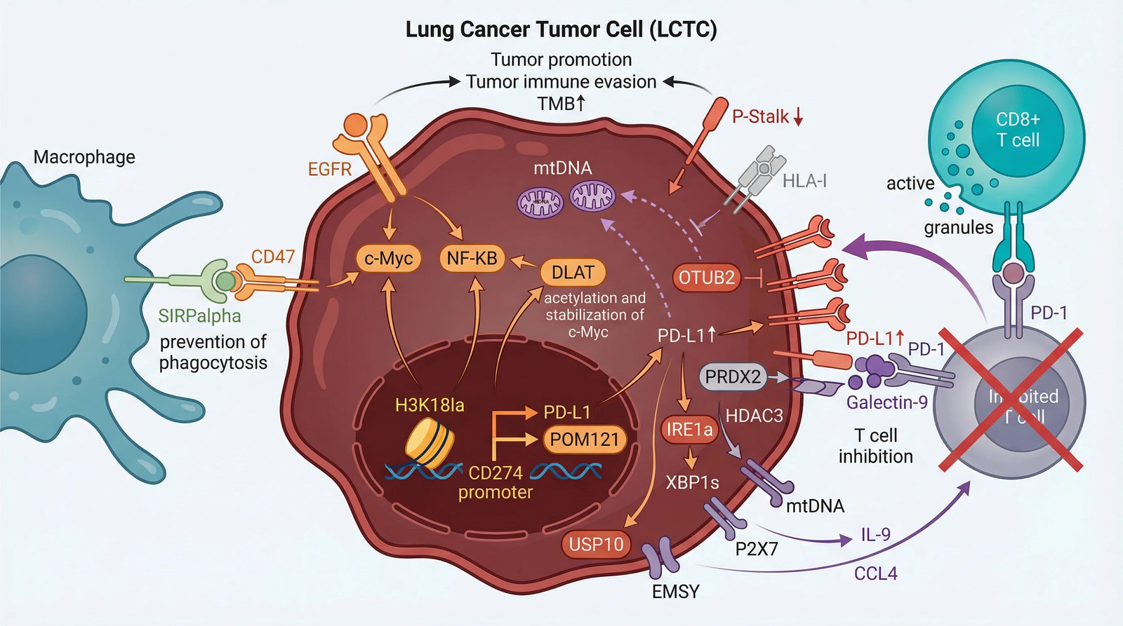
I · RESEARCH BACKGROUND
Introduction
Tumors evade immune clearance through a small number of recurring mechanisms, and most of them converge on the tumor microenvironment.
Checkpoint blockade works in a minority of patients, and response does not track cleanly with tumor mutational burden.
Highlight or bold the keywords you want remembered — two or three per slide, no more.
Need a diagram like this? Describe it and create one in seconds at SciFig.
Notes:
💡 Only the background needed to follow what comes next.
🖼 This example figure was generated with SciFig — see the prompt at scifig.ai/go/slcb-prm
Template by SciFig
More free presentation templates for conferences, lab meetings, journal clubs and thesis defenses: scifig.ai/go/slcb-mor

Slide 6
I · RESEARCH BACKGROUND
One Figure, One Message
Drop your key figure here.
One slide, one message — if it needs two, make two slides.
No figure fits your data? Describe it and create one in seconds at SciFig.
Notes:
💡 The single figure this talk is built around.
Template by SciFig
More free presentation templates for conferences, lab meetings, journal clubs and thesis defenses: scifig.ai/go/slcb-mor

Slide 7
I · RESEARCH BACKGROUND
Knowledge Gap and Open Questions
What is not yet known
Questions this work asks
State it plainly. For example, "It is unclear whether the acidic microenvironment suppresses T cells directly or acts through the myeloid compartment."
Why the gap has persisted. For example, "pH and myeloid content have never been varied independently in vivo."
What closing it would change. For example, "It would tell us which compartment to target first."
Can pH and myeloid content be varied independently in vivo?
Does buffering restore T cell function on its own?
Which compartment does checkpoint response track with?
Notes:
💡 What is unknown, why it stayed unknown, and what closing it buys.
Template by SciFig
More free presentation templates for conferences, lab meetings, journal clubs and thesis defenses: scifig.ai/go/slcb-mor

Slide 8
II · HYPOTHESIS AND OBJECTIVES
The Testable Claim
We hypothesize that buffering the acidic tumor microenvironment will restore cytotoxic T cell function in checkpoint-refractory lung tumors.
The same shape, blank: "We hypothesize that [independent variable] will [expected effect] on [dependent variable] in [population or condition]."
Keep it testable, specific and falsifiable.
Notes:
💡 The one sentence the whole talk is built to test.
Template by SciFig
More free presentation templates for conferences, lab meetings, journal clubs and thesis defenses: scifig.ai/go/slcb-mor

Slide 9
II · HYPOTHESIS AND OBJECTIVES
Research Objectives
1
What you set out to measure. For example, "To quantify how knockout of the regulator changes pathway output over 24 hours."
2
What you set out to compare. For example, "To compare the knockout against a wild-type rescue as a specificity control."
3
What you set out to validate. For example, "To confirm the phenotype in a second, independent cell line."
4
What you set out to replicate. For example, "To repeat the time-course with an independent guide RNA."
Notes:
💡 Each objective maps one-to-one onto a row of the summary table.
Template by SciFig
More free presentation templates for conferences, lab meetings, journal clubs and thesis defenses: scifig.ai/go/slcb-mor

Slide 10
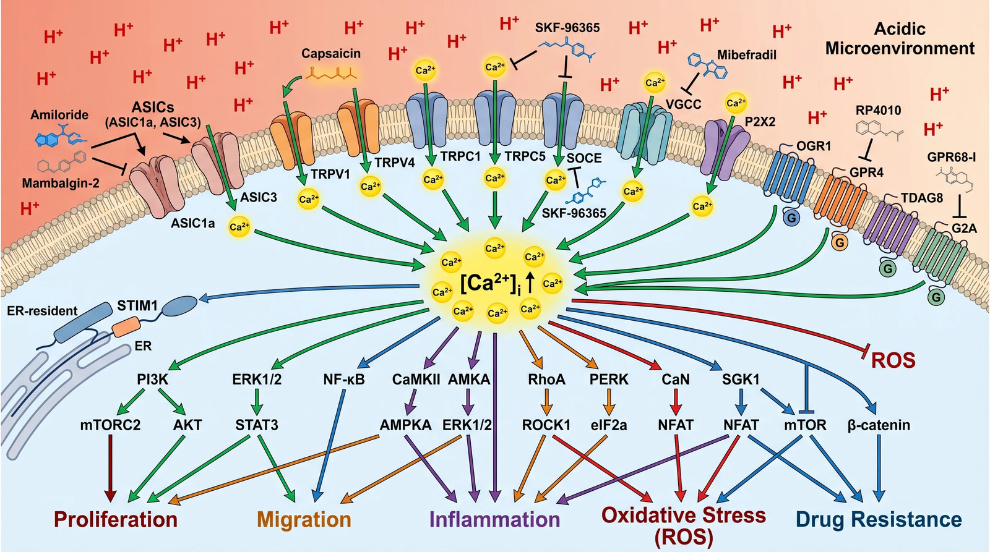
III · METHODOLOGY
Study Design and Methods
Study design and sample size. For example, "Syngeneic model, n = 10 per arm, powered for a 30 percent change in tumor volume."
Key technique and why. For example, "Multiplex imaging rather than bulk cytometry, because spatial context is the variable of interest."
Controls and statistics. For example, "Vehicle plus isotype as the control arm; significance at alpha = 0.05."
Need a diagram like this? Describe it and create one in seconds at SciFig.
Notes:
💡 Design, technique, controls, and statistics.
🖼 This example figure was generated with SciFig — see the prompt at scifig.ai/go/slcb-prm
Template by SciFig
More free presentation templates for conferences, lab meetings, journal clubs and thesis defenses: scifig.ai/go/slcb-mor

Slide 11
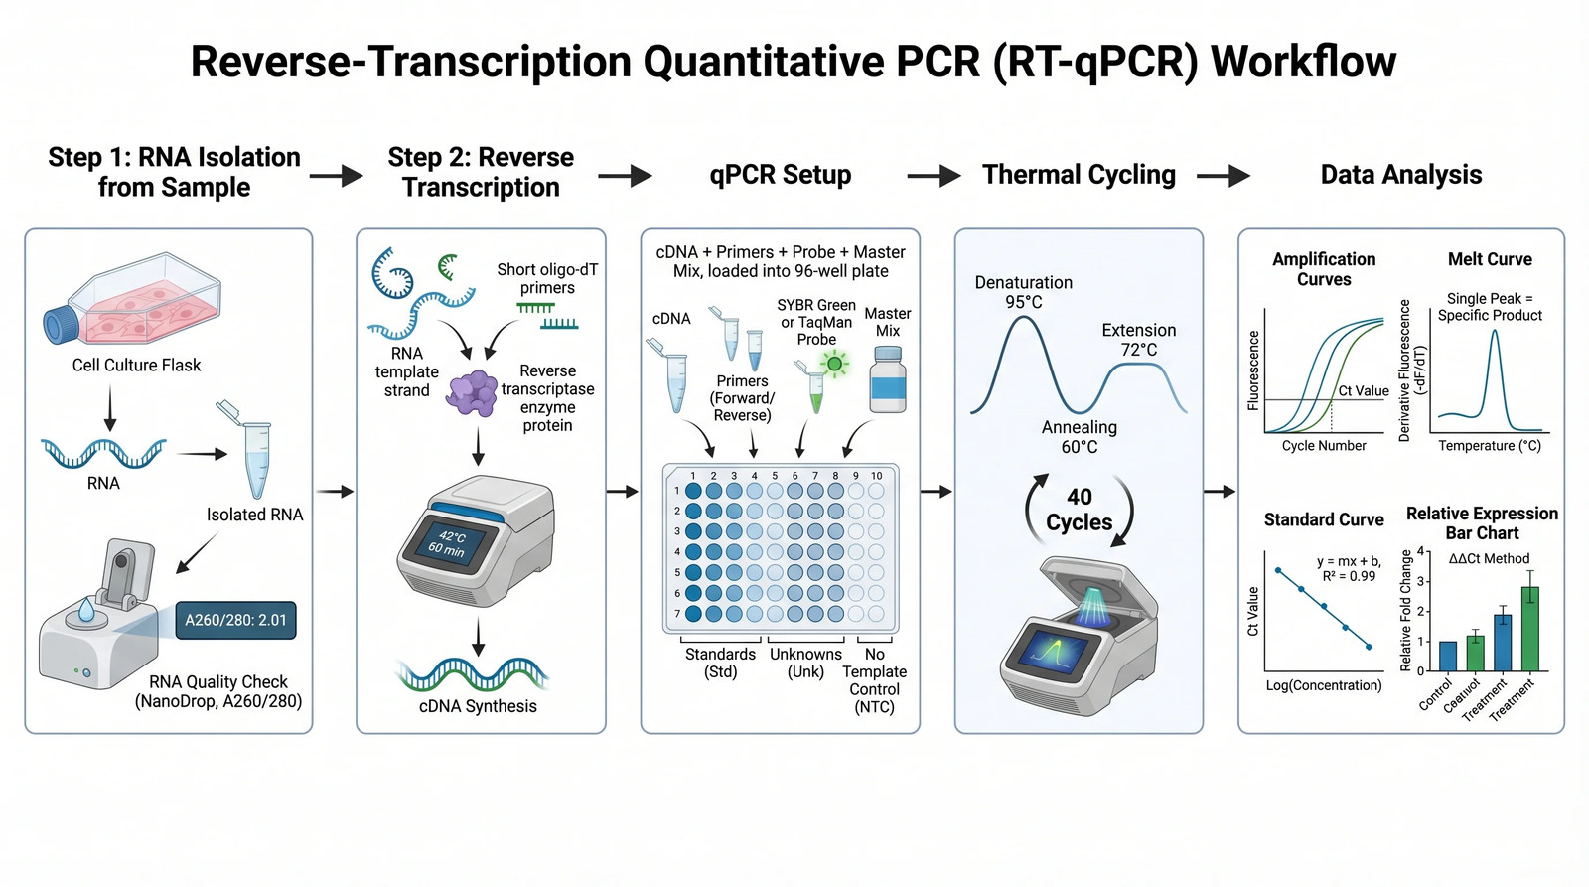
III · METHODOLOGY
Experiment Timeline
Phase 1 — setup and validation. For example, "Months 1-3: line generation, guide validation, and assay calibration."
Phase 2 — main data collection. For example, "Months 4-9: full time-course across both guides, three replicates each."
Phase 3 — replication and analysis. For example, "Months 10-12: second cell line and final analysis."
Need a diagram like this? Describe it and create one in seconds at SciFig.
Notes:
💡 How long the work took, and whether it is finished.
🖼 This example figure was generated with SciFig — see the prompt at scifig.ai/go/slcb-prm
Template by SciFig
More free presentation templates for conferences, lab meetings, journal clubs and thesis defenses: scifig.ai/go/slcb-mor

Slide 12
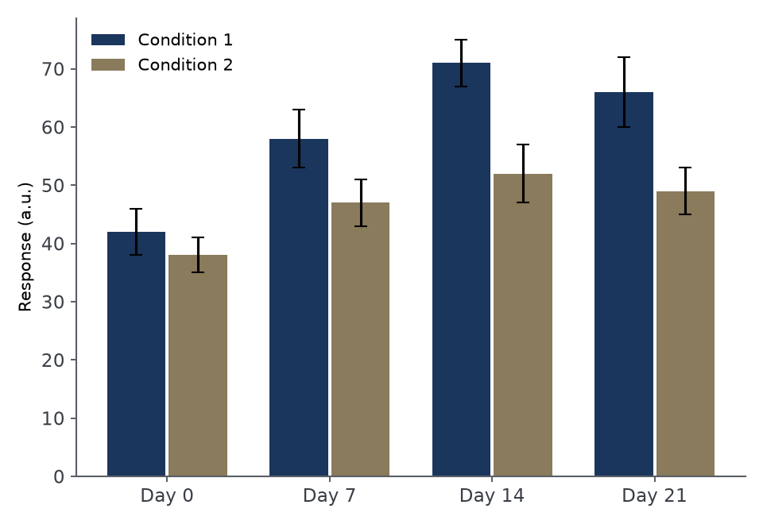
IV · RESULTS
Result 1 — For Example, "Knockout Sustains Pathway Activation Past 12 Hours"
Lead with what you found in plain language, then point at the part of the figure that shows it.
Give the effect size and its uncertainty, not just the p-value. For example, "2.4-fold higher at 12 h (95% CI 1.8-3.1)."
Title this slide with the finding rather than with "Result 1" — a title that states the result does half the talking for you.
Describe this figure in one line: what is plotted, and what it shows.
Notes:
💡 What was found, with effect size and uncertainty.
🖼 This example figure was generated with SciFig — see the prompt at scifig.ai/go/slcb-prm
Template by SciFig
More free presentation templates for conferences, lab meetings, journal clubs and thesis defenses: scifig.ai/go/slcb-mor

Slide 13
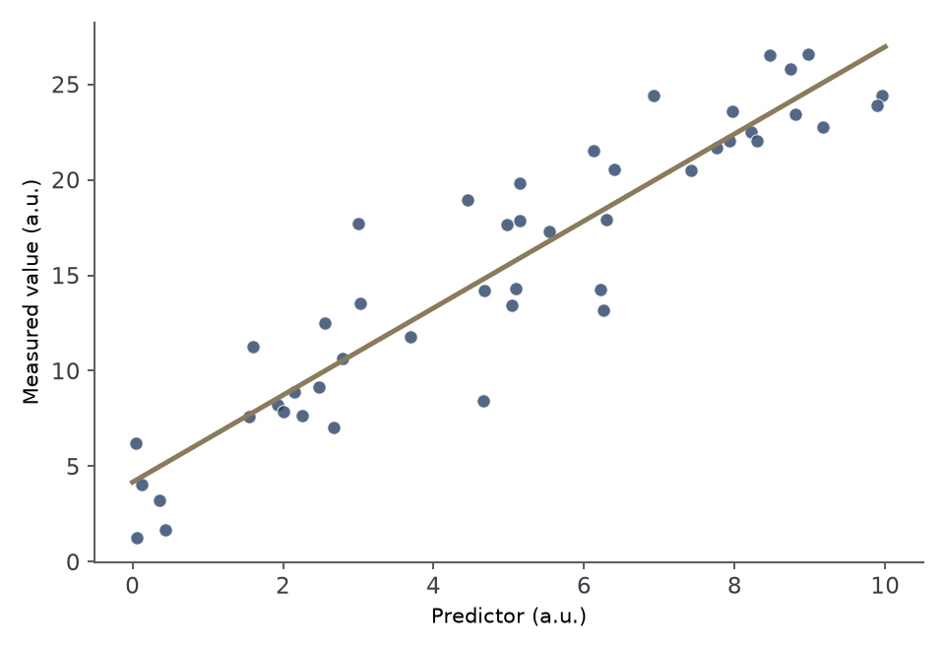
IV · RESULTS
Result 2 — For Example, "The Effect Scales With Baseline Expression"
What changed between conditions. For example, "The same trend held in the replication line, with a smaller slope."
Any result that went against your expectation — say it here. For example, "The rescue only partially reversed the phenotype."
Say what the axes are before you say what they mean.
Describe this figure in one line: what is plotted, and what it shows.
Notes:
💡 What changed between conditions, including anything unexpected.
🖼 This example figure was generated with SciFig — see the prompt at scifig.ai/go/slcb-prm
Template by SciFig
More free presentation templates for conferences, lab meetings, journal clubs and thesis defenses: scifig.ai/go/slcb-mor

Slide 14
IV · RESULTS
Summary of Findings
Objective | What we found | Confidence
Quantify pathway output | Activation sustained 2.4-fold past 12 h | High
Compare against rescue | Rescue reverses the effect only partially | Moderate
Validate in a second line | Same direction, smaller effect size | Preliminary
Replicate with a second guide | Consistent, with a wider confidence interval | Moderate
Notes:
💡 One row per objective, with how far each result can be pushed.
Template by SciFig
More free presentation templates for conferences, lab meetings, journal clubs and thesis defenses: scifig.ai/go/slcb-mor

Slide 15
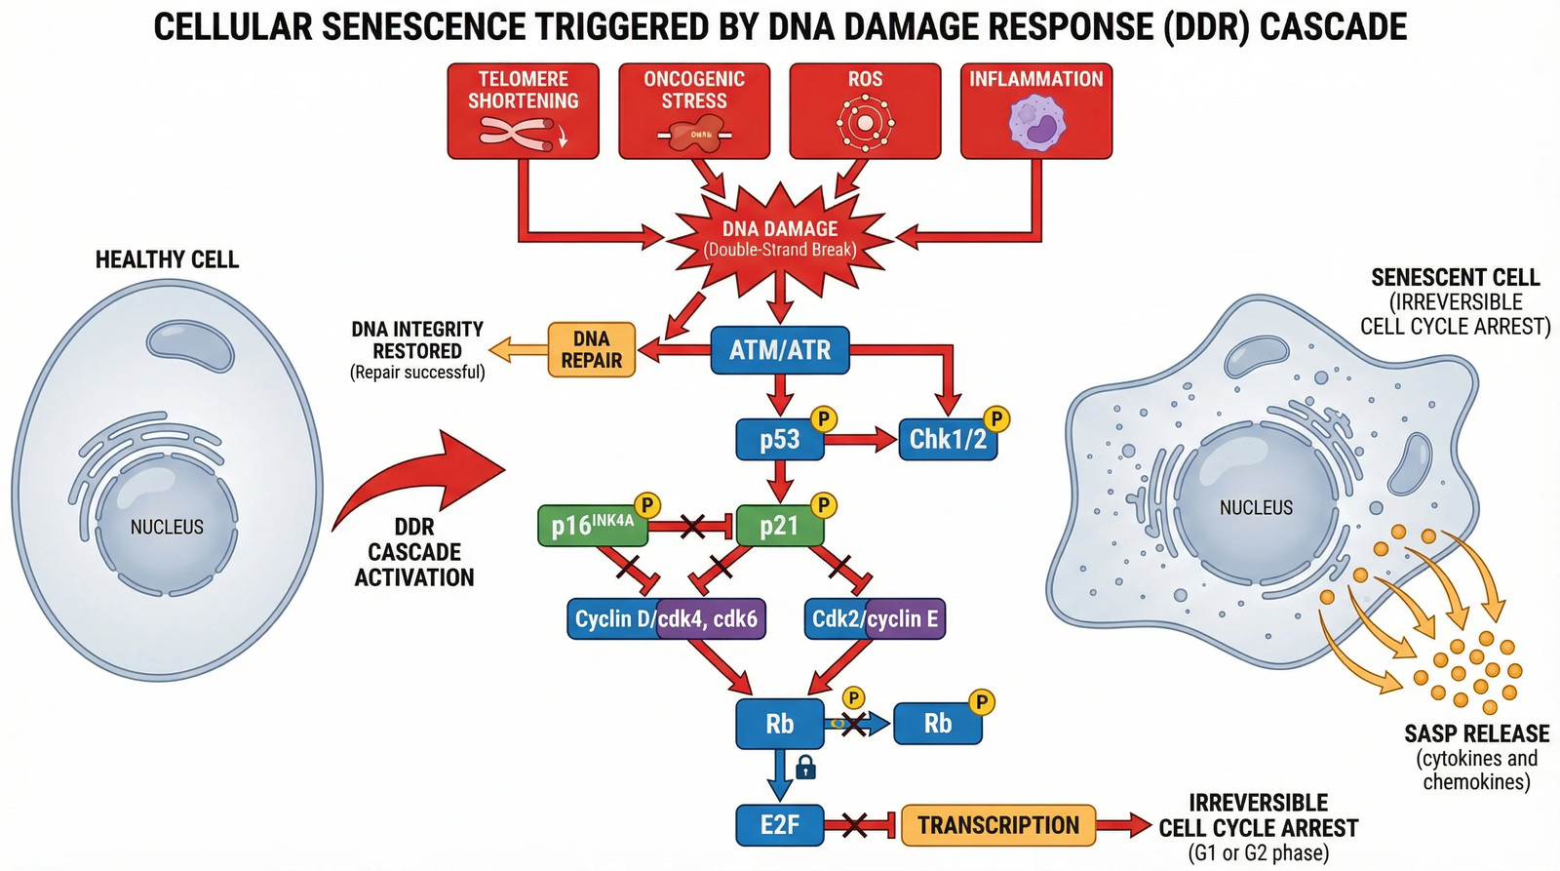
V · DISCUSSION AND NEXT STEPS
What the Results Mean
What it means for the field. For example, "This places the acidity effect upstream of checkpoint expression, not parallel to it."
How it fits or clashes with prior work. For example, "It disagrees with the 2024 buffering study, which used a model without a myeloid-rich stroma."
The limitation a reviewer raises first. For example, "Single syngeneic model, and no human validation cohort yet."
Need a diagram like this? Describe it and create one in seconds at SciFig.
Notes:
💡 What the results mean beyond this project, and the limitation that matters most.
🖼 This example figure was generated with SciFig — see the prompt at scifig.ai/go/slcb-prm
Template by SciFig
More free presentation templates for conferences, lab meetings, journal clubs and thesis defenses: scifig.ai/go/slcb-mor

Slide 16
V · DISCUSSION AND NEXT STEPS
Troubleshooting
What is not working
What would unblock it
What broke, and what you already tried. For example, "The assay drifts after passage 12; fresh thaws and recalibration did not fix it."
The failure mode you suspect. For example, "Clonal drift, not reagent variability — it tracks with passage number, not lot."
How far it sets the timeline back.
A second pair of hands for the passage-matched repeat.
An assay that does not depend on late-passage cells.
Access to the earlier frozen stock, if it still exists.
Notes:
💡 Where the work is blocked, and what would unblock it.
Template by SciFig
More free presentation templates for conferences, lab meetings, journal clubs and thesis defenses: scifig.ai/go/slcb-mor

Slide 17
V · DISCUSSION AND NEXT STEPS
Remaining Questions and Next Steps
Questions still open
What comes next
The question this work opened up. For example, "Does the partial rescue mean a second regulator is involved?"
The result that would change the interpretation if it did not hold.
The assumption the whole model still rests on.
The experiment that would answer it. For example, "A double knockout with the candidate regulator, on the same time-course."
What it would take to run. For example, "Two months of scope time and access to the primary tissue bank."
What would have to be true before scaling this up.
Notes:
💡 The question this opened, and what it would take to answer it.
Template by SciFig
More free presentation templates for conferences, lab meetings, journal clubs and thesis defenses: scifig.ai/go/slcb-mor

Slide 18
References
1. Author, A. A., Author, B. B., & Author, C. C. (Year). Title of the article. Title of the Journal, volume(issue), page range. https://doi.org/10.0000/example
2. Author, D. D., & Author, E. E. (Year). Title of the article. Title of the Journal, volume(issue), page range. https://doi.org/10.0000/example
3. Author, F. F., et al. (Year). Title of the article. Title of the Journal, volume(issue), page range. https://doi.org/10.0000/example
4. Author, G. G., & Author, H. H. (Year). Title of the preprint. Preprint server. https://doi.org/10.0000/example
5. Author, I. I., et al. (Year). Title of the dataset [Data set]. Repository. https://doi.org/10.0000/example
6. Author, J. J., & Author, K. K. (Year). Title of the chapter. In Editor (Ed.), Title of the book (pp. 000-000). Publisher.
7. Author, L. L., et al. (Year). Title of the article. Title of the Journal, volume(issue), page range. https://doi.org/10.0000/example
Notes:
💡 Full citations for everything referenced in the talk.
Template by SciFig
More free presentation templates for conferences, lab meetings, journal clubs and thesis defenses: scifig.ai/go/slcb-mor

Slide 19
THANK YOU
Acknowledgments
Lab or department
Collaborators and funding
Name — principal investigator
Name — co-first author
Name — sequencing and analysis
Name — animal work
Name — imaging support
Name
Name — collaborating lab
Name — statistics
Name — clinical samples
NIH Grant No. XYZ12345
NSF Grant No. ABC67890
your.email@institution.edu
Insert a picture of your team here
Name of Institution or University
QR code to your paper, preprint, dataset or lab page
Make a QR code free
Notes:
💡 Who contributed what, plus funding and contact details.
Template by SciFig
More free presentation templates for conferences, lab meetings, journal clubs and thesis defenses: scifig.ai/go/slcb-mor

Slide 20
Supplementary Resources
The next slides hold ready-made figures and icons you can drop straight into this deck — and a link to the rest.
Notes:
💡 A divider: everything after this is reference material, not the talk.
Template by SciFig
More free presentation templates for conferences, lab meetings, journal clubs and thesis defenses: scifig.ai/go/slcb-mor

Slide 21
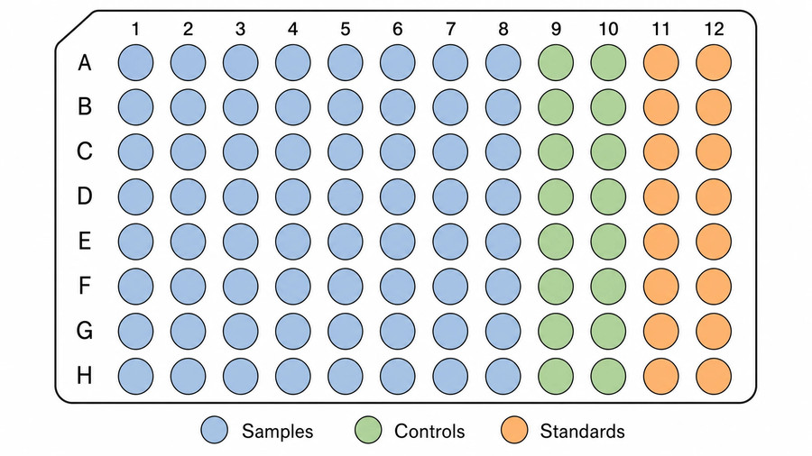
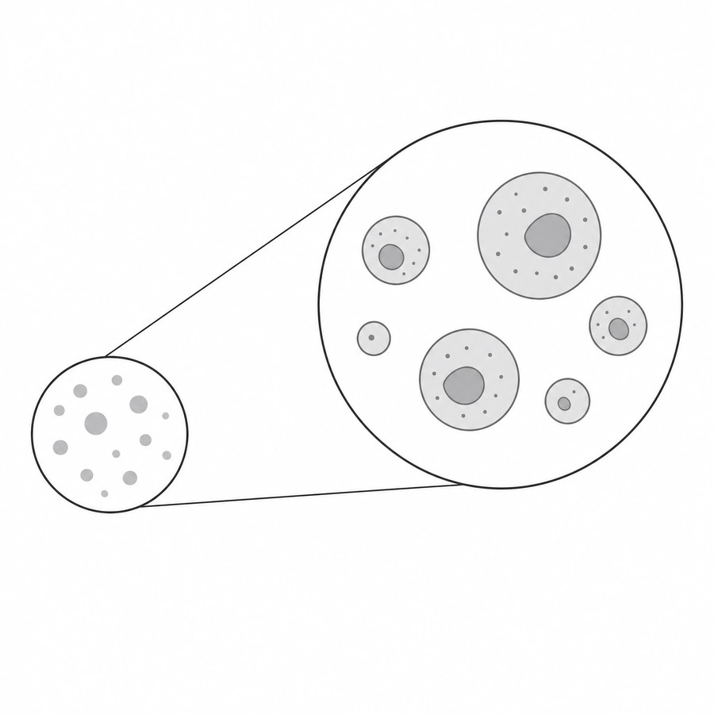
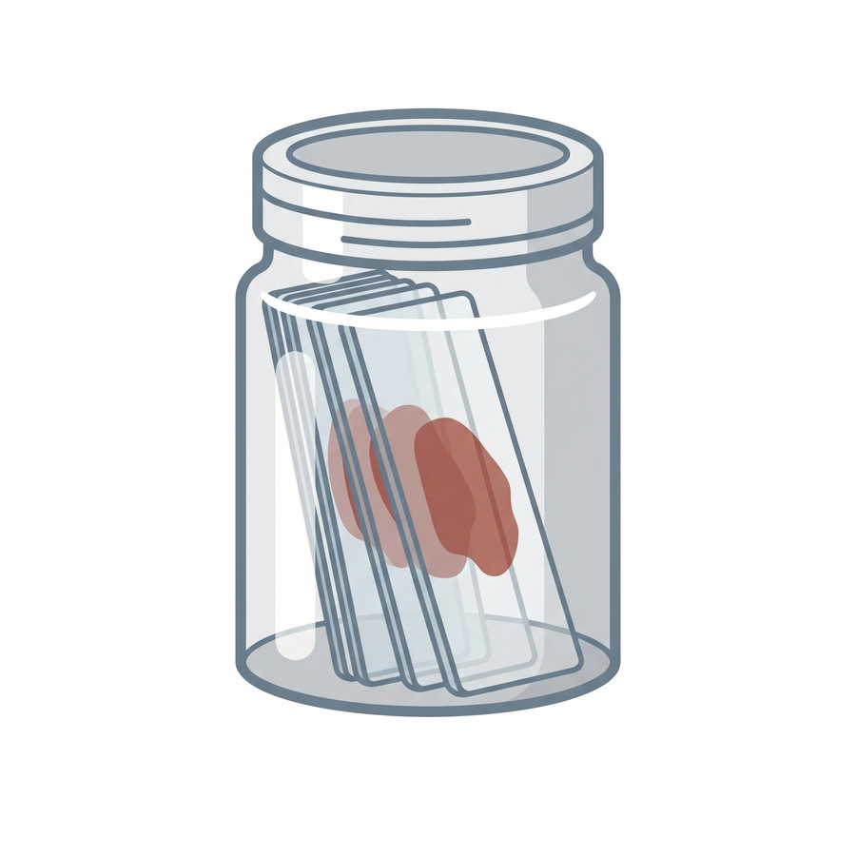
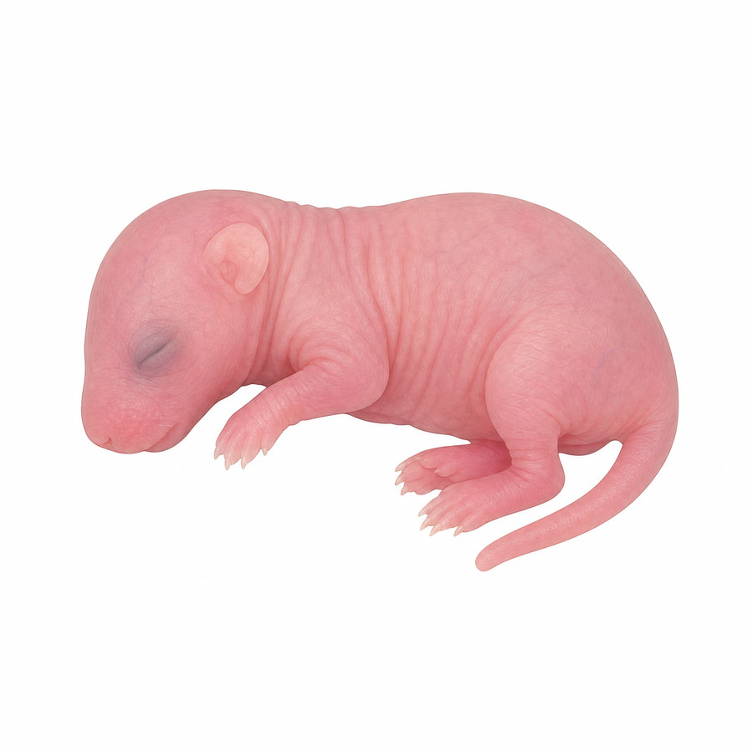
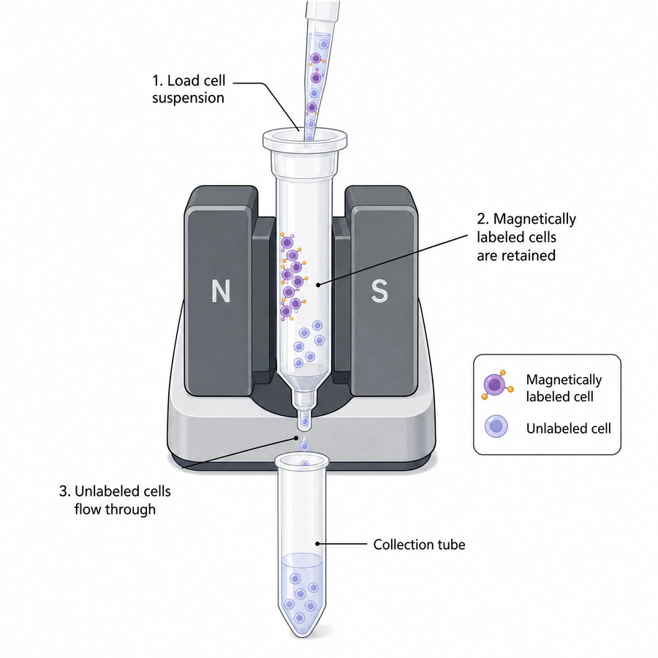
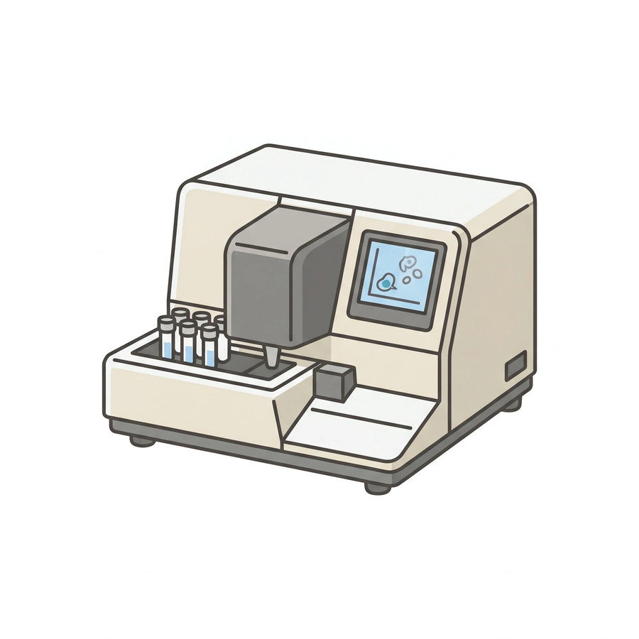
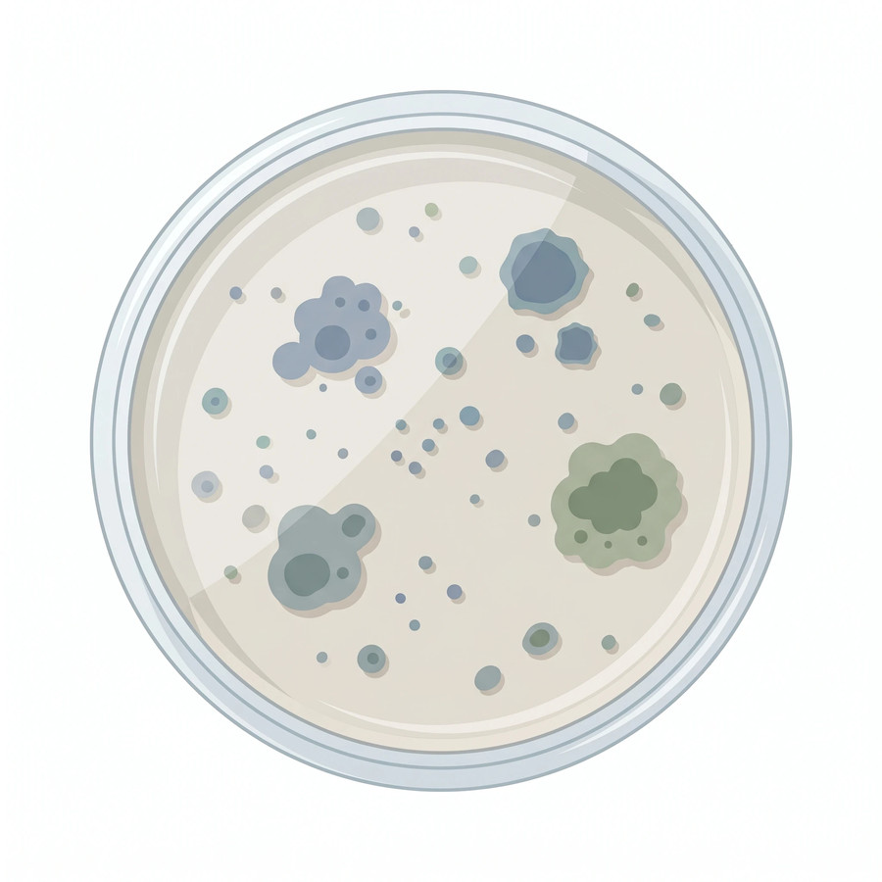
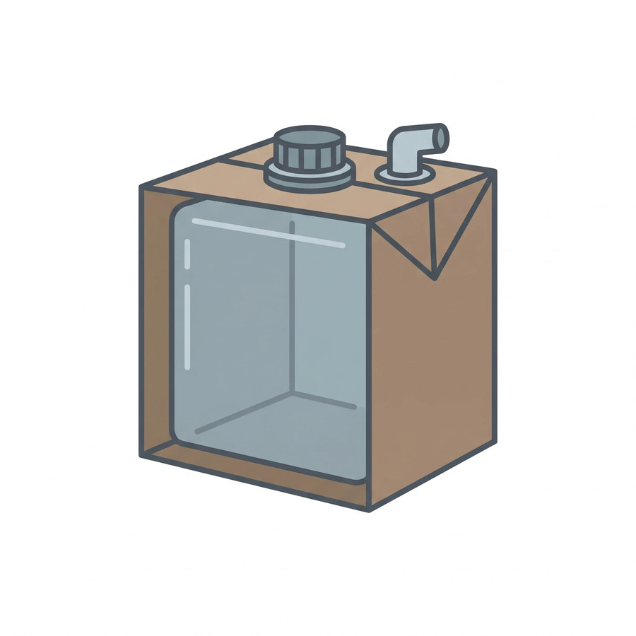
Resources: Lab Equipment and Consumables
Use these resources to level up your presentation
96-well plate
Zoomed callout
Coplin jar
Lab mouse
Magnetic cell separator
Imaging flow cytometer
Petri dish
Cubitainer
Browse free scientific icons at SciFig — or generate any figure free.
Notes:
💡 Ready-made assets — swap any of these straight into your slides.
Template by SciFig
More free presentation templates for conferences, lab meetings, journal clubs and thesis defenses: scifig.ai/go/slcb-mor

Slide 22
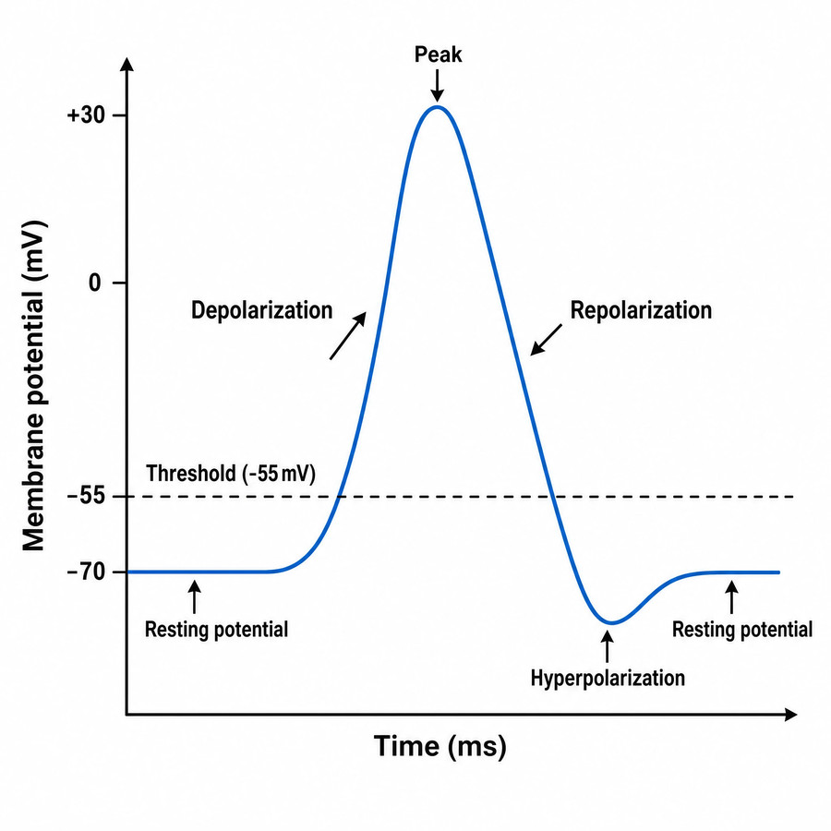
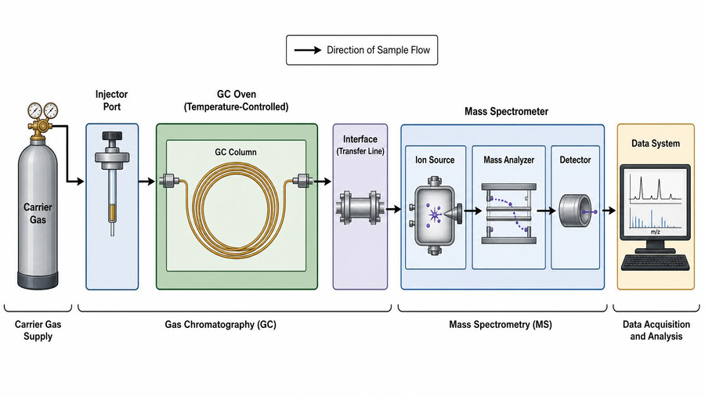
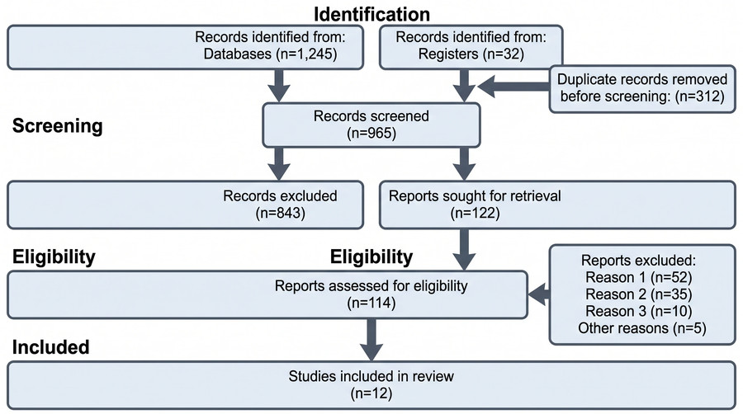
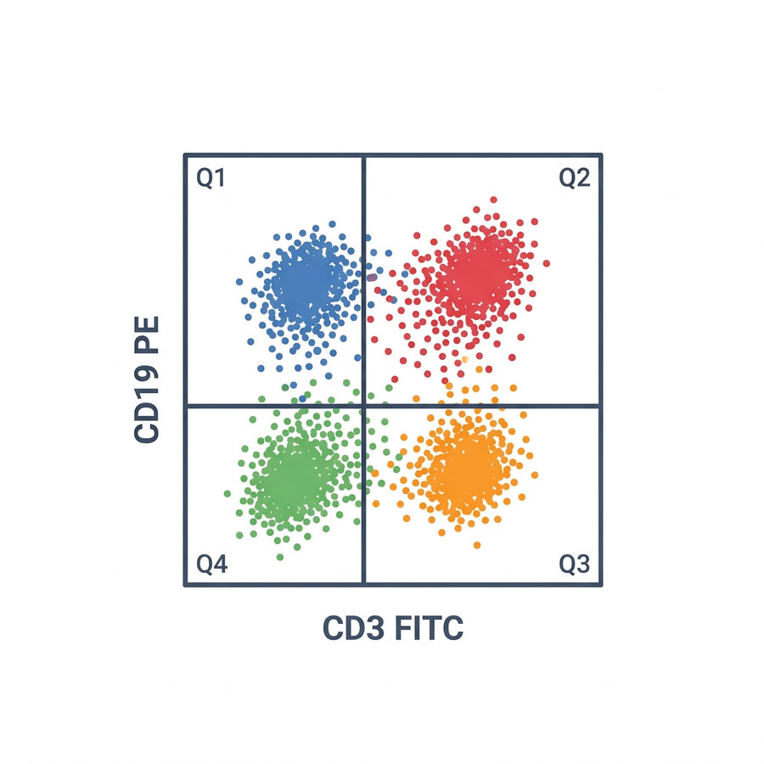
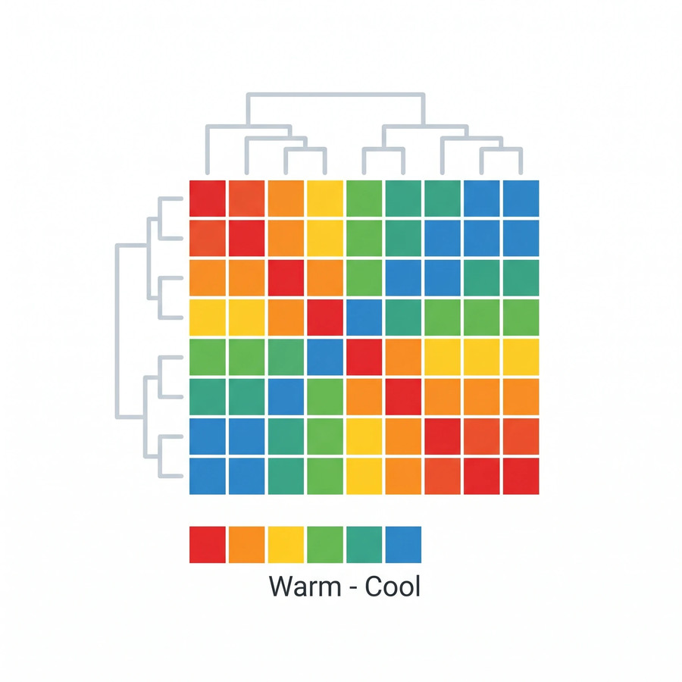
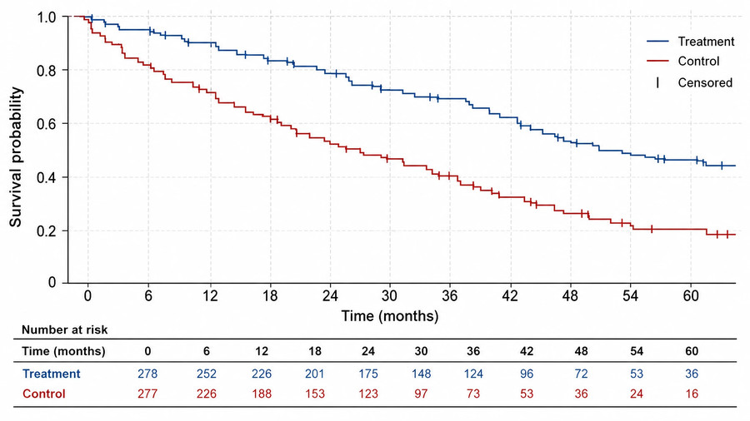
Resources: Data and Analysis Figures
Use these resources to level up your presentation
Action potential
GC-MS schematic
PRISMA flow diagram
Flow cytometry plot
Heat map
Kaplan-Meier curve
Browse free figure templates at SciFig — or generate any figure free.
Notes:
💡 Chart and workflow figures you can adapt to your own numbers.
Template by SciFig
More free presentation templates for conferences, lab meetings, journal clubs and thesis defenses: scifig.ai/go/slcb-mor

Slide 23
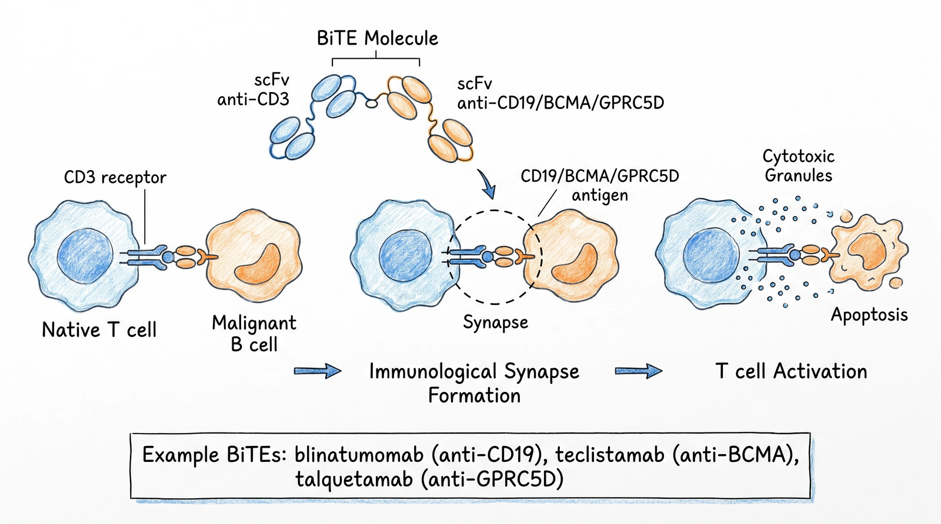
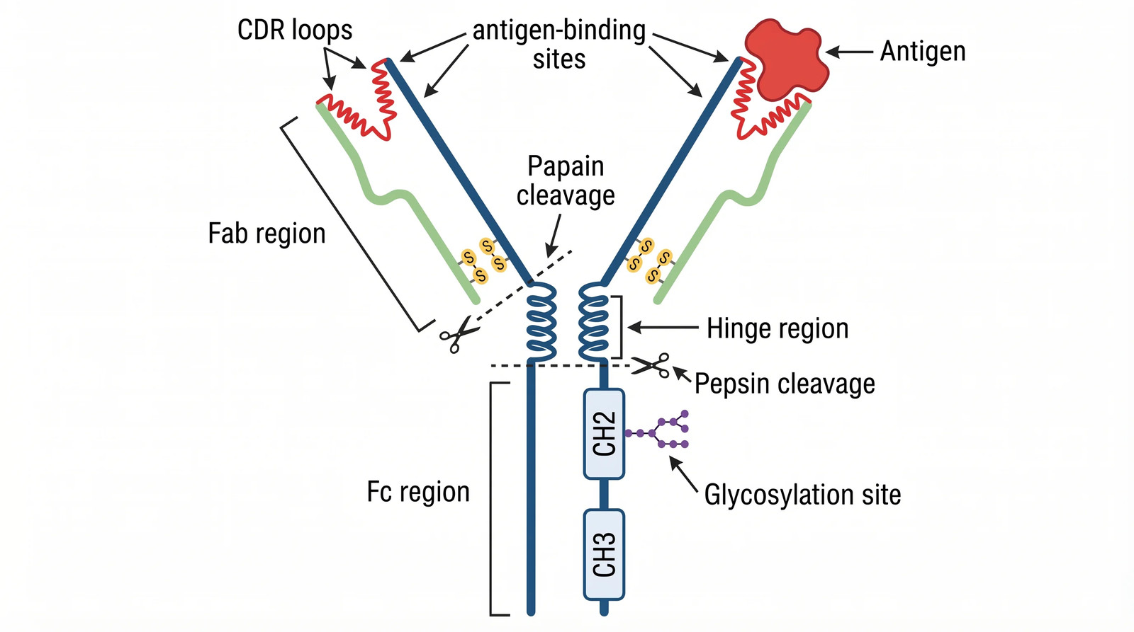
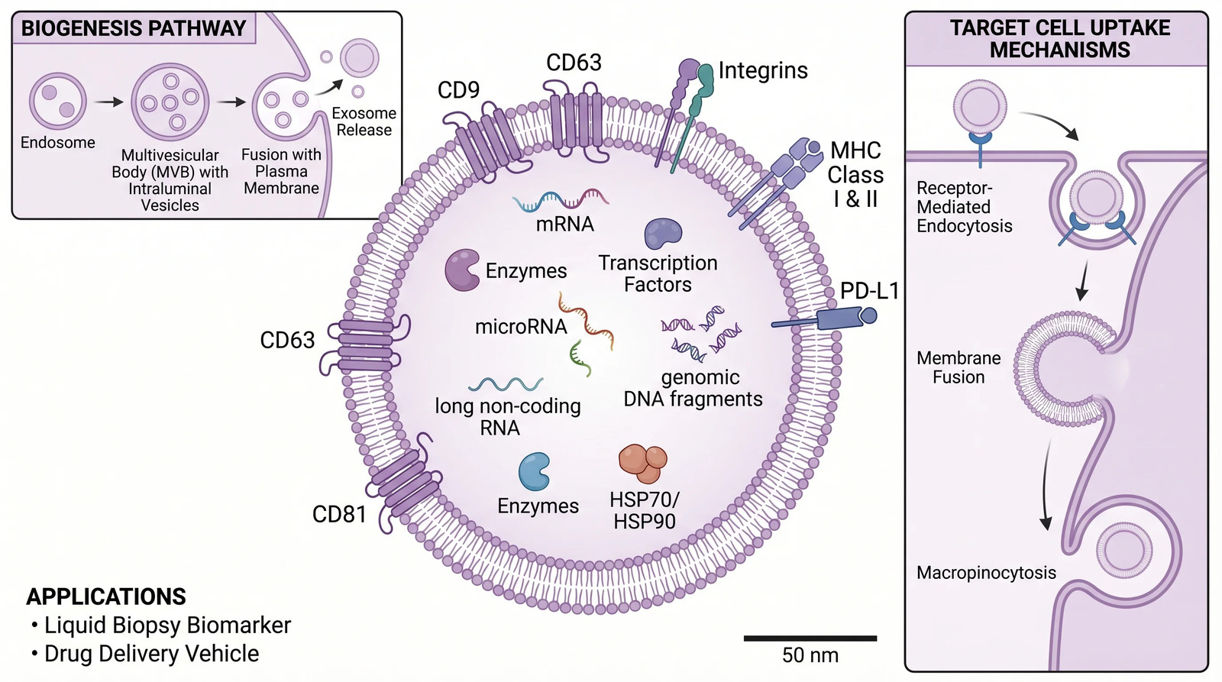
Resources: Tumor Immunology Figures
Use these resources to level up your presentation
Browse the full figure gallery at SciFig — or generate any figure free.
Notes:
💡 Field-specific figures — every one of these was generated from a prompt.
Template by SciFig
More free presentation templates for conferences, lab meetings, journal clubs and thesis defenses: scifig.ai/go/slcb-mor

